Slide 1
Is there any wriggle room to restrict free movement of persons using existing EU tools?
Catherine Barnard
Trinity College
Cambridge

Slide 2
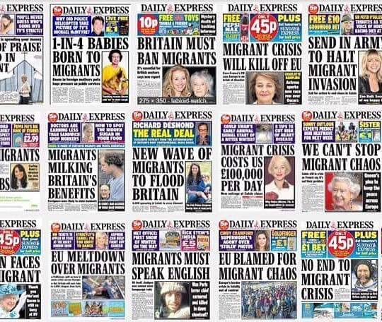

Slide 3
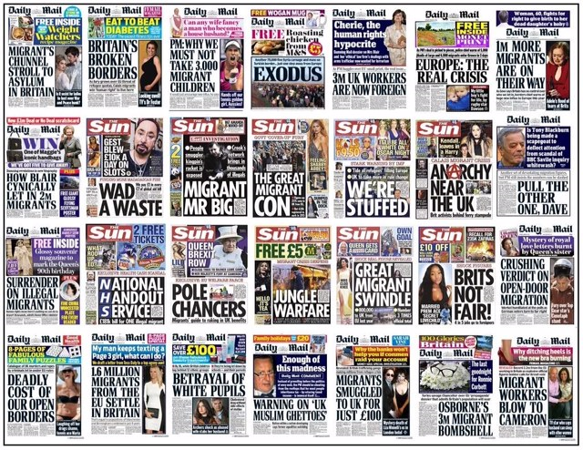

Slide 4
Migration Watch
At present immigration is neither sustainable nor well managed. In 2015 net migration was over 300,000. If net migration continues at recent levels the latest ONS statistics project that our population will increase by 500,000 per year - the equivalent of a new city the size of Liverpool every year.

Slide 5
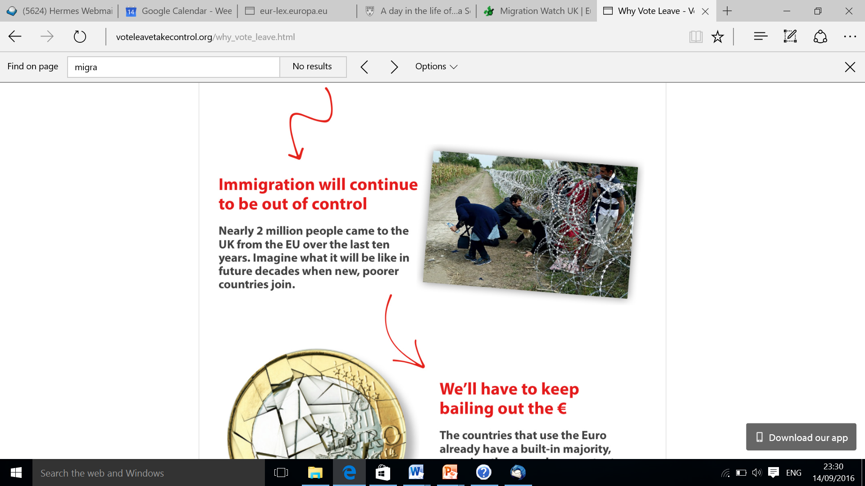

Slide 6
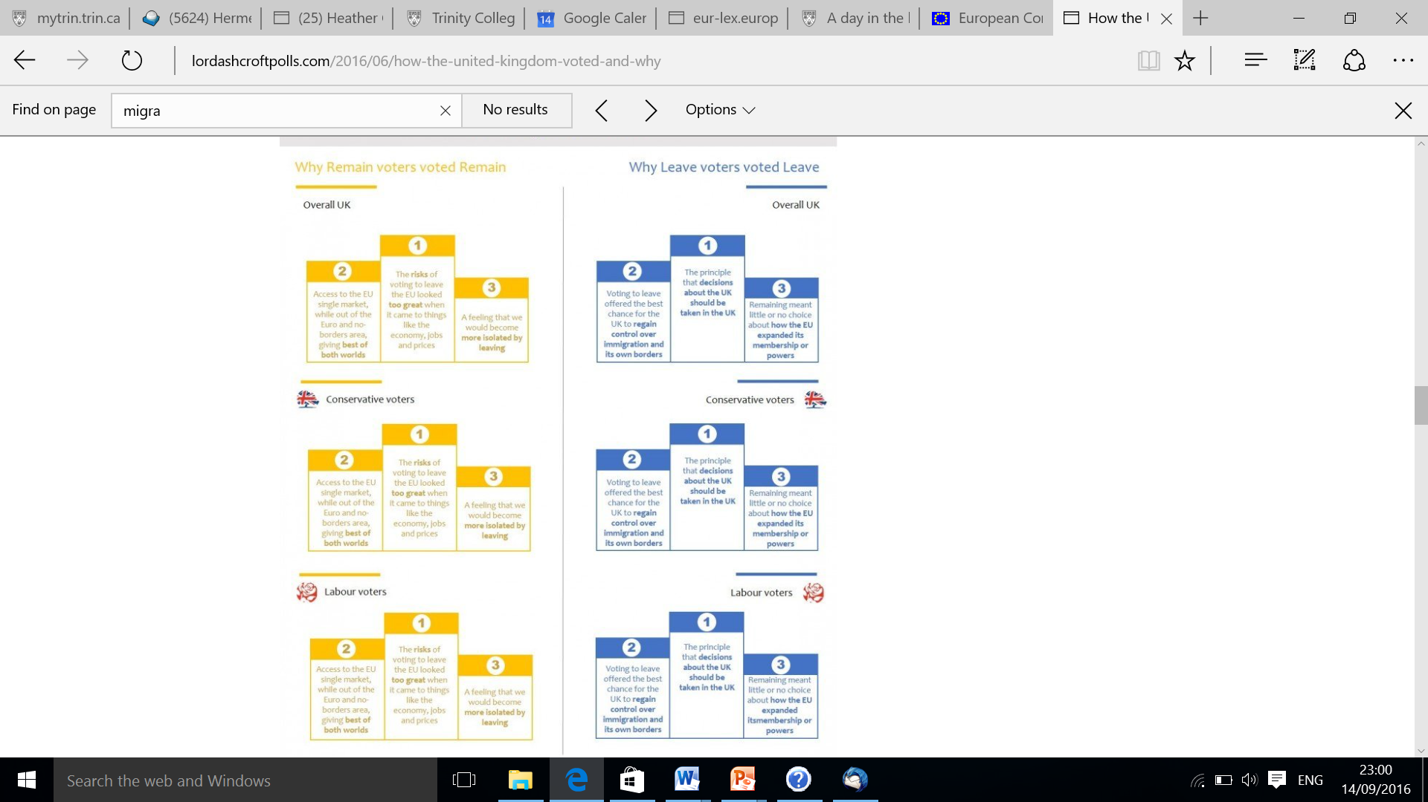

Slide 7
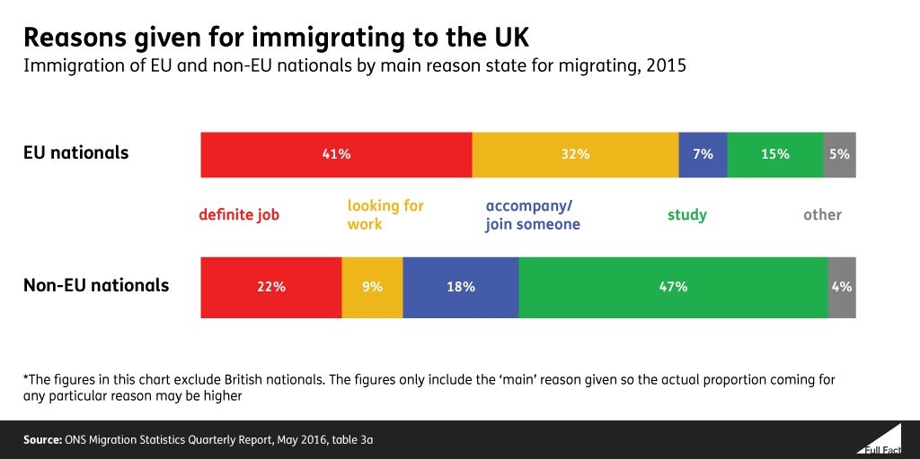

Slide 8
Brussels Decision
‘Free movement of workers within the Union is an integral part of the internal market which entails, among others, the right for workers of the Member States to accept offers of employment anywhere within the Union. … ‘

Slide 9
Brussels Decision
It is legitimate to take this situation into account [namely different levels of remuneration between Member States and different levels of remuneration] and to provide, both at Union and at national level, and without creating unjustified direct or indirect discrimination, for measures limiting flows of workers of such a scale that they have negative effects both for the Member States of origin and for the Member States of destination

Slide 10
Brussels Decision
Whereas the free movement of workers under Article 45 TFEU entails the abolition of any discrimination based on nationality as regards employment, remuneration and other conditions of work and employment, this right may be subject to limitations on grounds of public policy, public security or public health. In addition, if overriding reasons of public interest make it necessary, free movement of workers may be restricted by measures proportionate to the legitimate aim pursued. Encouraging recruitment, reducing unemployment, protecting vulnerable workers and averting the risk of seriously undermining the sustainability of social security systems are reasons of public interest recognised in the jurisprudence of the Court of Justice of the European Union for this purpose, based on a case by case analysis.

Slide 11
Fig 1 Discrimination model
National measure
Direct discrimination
Breach of Arts. 45, 49, 56, 63 TFEU
Saved by express derogations only + FHR + proportionality (+ procedural protection)
Indirect discrimination
Breach of Arts. 45, 49, 56, 63 TFEU
Saved by express derogations and justifications + FHR + proportionality (+ procedural protection)

Slide 12
Spaak report
une interpretation correcte de la notion de libre circulation des travailleurs: il comporte Ie droit de se presenter dans tout pays de Ia Communaute aux emplois effectivement offerts et de demeurer dans ce pays, si un emploi est effectivement obtenu, sans aucune restriction qui ne s’applique de la mȇme manière aux travailleurs nationaux eux-mȇmes

Slide 13
Spaak report
II sera necessaire de prévoir certaines clauses de sauvegarde administrées par la Commission européenne, pour Ie cas où l' afflux de main- oeuvre créerait un risque particulier pour Ie niveau de vie ou d' emploi des travailleurs d'industries determinées dans certains pays. Toutefois, les droits acquis des travailleurs étrangers ne doivent pas etre affectés par ces mesures.

Slide 14
British Future Poll
Only 12% of people would like to see a reduction in the numbers of highly skilled workers migrating to Britain; nearly four times as many (46%) would like to see more of it, with 42% saying that it should stay the same. Among people who voted Leave in the referendum these numbers remain broadly the same: 45% would like to see an increase, 40% say that the numbers should stay as they are and just 15% would like to see them reduced.
Only a fifth of people (22%) would like the number of international students coming to study at Britain’s universities to be reduced, less than the 24% who would be happy for them to increase. The majority (54%, including 50% of Leave voters) would rather the numbers stayed the same. Students made up over a quarter of immigration flows to the UK last year .
Most people (52%) would be happy for the number of people joining immediate family in the UK to remain the same. 13% think it should be increased while 35% would prefer it reduced.
People are less positive about low-skilled workers moving to the UK, however: while four in ten (38%) would be happy for numbers to stay the same (31%) or increase (7%), six in ten (62%) would prefer the numbers to be reduced

Slide 15
State of the Union address
An integral part of our European way of life is our values. … We Europeans can never accept Polish workers being harassed, beaten up or even murdered on the streets of Harlow. The free movement of workers is as much a common European value as our fight against discrimination and racism.

