Slide 1

Where EU free movement and benefits law went ‘wrong’
Charlotte O’Brien, University of York

Slide 2
An age of esablishment-sponsored anti-enlightenment
Programme of scapegoating
‘UK wide open to ‘free loading’ EU migrants’
‘Tax credits turned UK into ‘honeypot’ for EU immigrants’
‘Four years of EU migrants coming here will fill a city the size of Manchester’
‘Free movement within Europe needs to be less free’

Slide 3
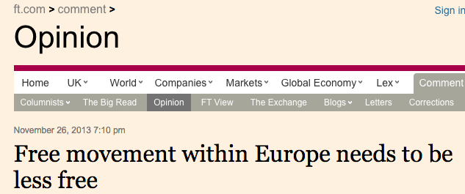

Slide 4
David Cameron in The Telegraph
We’re also making sure people come for the right reasons – which has meant addressing the magnetic pull of Britain’s benefits system. We changed the rules so that no one can come to this country and expect to get out-of-work benefits immediately

Slide 5
Government press releases
‘Accelerating action to stop rogue EU benefit claims’
‘Tough new rules come into force to ensure that migrants don’t take advantage of the British benefits system.’
‘the Prime Minister has made it clear that abuse and clear exploitation of the UK’s welfare system will not be tolerated.’
Both government and opposition apparently angry about the ‘absurdity’ of Child Benefit exportation

Slide 6
Punitive changes dehumanised EU nationals
Scrapping HB for jobseekers
Introduction Minimum Earnings Threshold
Genuine Prospects of Work Test
Interaction effects – impacts upon vulnerable minority
EU nationals a test-bed for untrammelled conditionality?
Notes:
And also dehumanised us, too?

Slide 7
Disregard of empirical evidence
On benefits
  EU Commission – including DWP contribution
  CREAM findings
  LSE findings
  NIESR
On labour markets
  ‘lump of labour’ fallacy
  Perceptions about wage depression
  Government – Migration Advisory Committee
  EU Commission research
  NIESR
Balance of competences review
Notes:
More likely than UK nationals to be in work
If not in work – little benefit entitlement
Increasingly the case for workers
Economic growth – more jobs
Small impact on wages
Commission evidence
UK Balance of Competences Review

Slide 8
The rhetoric of the campaigns
No pro-free movement message
Vote Leave messages and claims
Mainstay of the ‘Remain’ campaign – the New Settlement
Collusion of the Commission
Interventions by the ECJ
Targeting low pay workers
  Undermining Art 45
  Asymmetric effects grounds of sex
Notes:
“Even if we could use it, the Independent Office of Budget Responsibility has said, the ‘emergency brake’ will have ‘not much’ impact on migration”
“the kind of information provided to it by the United Kingdom … shows the type of exceptional situation that the proposed safeguard mechanism is intended to
cover exists in the United Kingdom today. Accordingly, the United Kingdom would be justified in triggering the mechanism in the full expectation of
obtaining approval”.

Slide 9
Where next?
EEA/Swiss/Turkish/other options…
Quotas, points, and job-first systems
Are benefits the point?
Face up to distributional consequences of free movement
More reform at EU level? – from more protections for low paid workers to scrapping worker status
Also – mass deportations not feasible – rights of already resident EU nationals
EEA/full single market/option that retains some FMP may only be an option if FMP can be ‘sold’, or ‘repackaged’.
Evidence – balanced against post-fact political ‘truths’

Slide 10
