Slide 1
What next for Brexit Citizens CELS seminar 17 October 2018
Professor Eleanor Spaventa
Law Department, Bocconi University, Milan
.

Slide 2
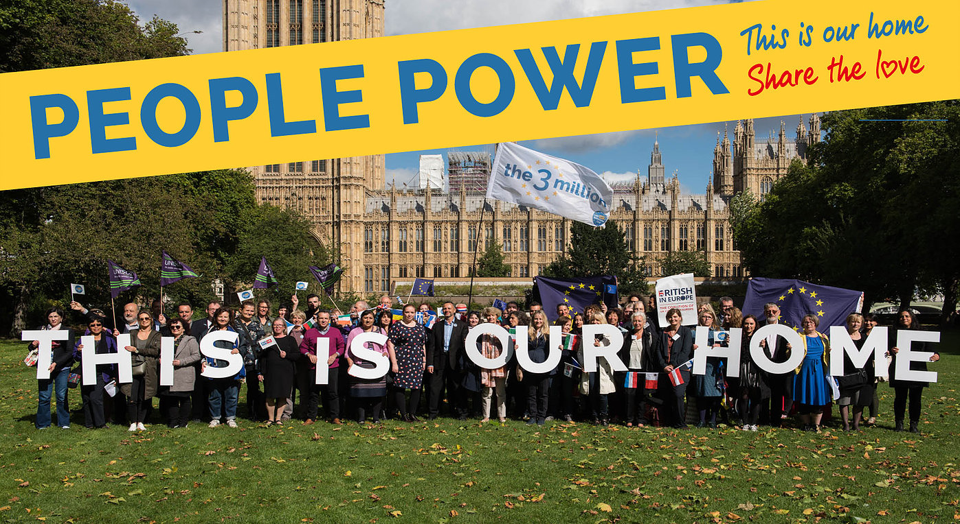
Outline
“Please do not turn us from Bargaining Chips to
Collateral Damage”

Slide 3
Why is there a problem for Brexit citizens?
Political will on both sides to protect Brexit Citizens(?)
UK decision to end free movement
Crumbling state of Union citizenship before Brexit → enlargement and financial crisis influence approach to FM; Cameron deal as illustrative
Retreat from fundamental status narrative →market citizen paradigm
Growing gap between bureaucratic and perceived citizenship rights

Slide 4
Union citizens right to reside: theory and practice
Right to reside in EU law conditional upon:
Economic activity (genuine and effective), including job seeking, or
Economic independence → comprehensive health insurance and sufficient resources
No systematic checks = after initial registration citizen might fall below and yet as long as no access to welfare all is fine → semi-statuses
NB After 5 years permanent residence (unconditional)

Slide 5
Political and legal challenges
UK → “taking back control” → wish to simply transition EU citizens from EU to (much more restrictive) UK immigration regime, esp for family reunification + criminality – pensioners in EU a small priority
UK → immediate reassurances to EU citizens
EU →prioritises EU citizens in UK (v problematic from EU citiz perspective), no reassurances (but EP very active)
EU → legal and political limits to generosity → bureaucratic market citizenship

Slide 6
Draft Withdrawal Agreement
DWA
Union/UK citizens protected as long as they are resident pursuant to Union law by 31st Dec 2020 (end of transition period) + work seekers + Family members (spouses + children also yet to be born)
After 5 years permanent residence (no longer conditions)
Lifelong protection only lost through expulsion on public policy grounds or absences for more than 5 years
But systematic criminality checks and conduct occurred after end of transition assessed pursuant to national law

Slide 7
Draft Withdrawal Agreement - who and what is excluded?
DWA
Own citizens (returning migrants – huge problem in UK)
Those residing pursuant to national law (gender problem)
Future spouses
Free movement rights for UK citizens
AND …… those who do not manage to meet conditions of economic activity / independence

Slide 8
Brexit citizens at risk
Ec Active
Economically active → Variable level of compliance esp. for atypical and part-time workers → risk of life long exclusion of genuine workers
UK workers do not gain free movement rights → locked in their Brexit country
Economically inactive → might not have CHI → gender, disability and age related impact
“Undesirables” at great risk → Public policy to be decided pursuant to domestic law for conduct occurred after end of transition

Slide 9
EU Citizens in UK

Slide 10
EU Citizens in UK
Not clear what evidence will be required esp for CHI – and part-time

Slide 11
EU Citizens in UK
Not clear what evidence will be required esp for CHI – and part-time
Public policy in UK broadly construed

Slide 12
EU Citizens in UK
Not clear what evidence will be required esp for CHI – and part-time
Public policy in UK broadly construed
Impact of hostile environment?

Slide 13
Hostile environment in action
(Source home office statistics)

Slide 14
UK Citizens in EU
No undertaking re CHI
No Free Movement
No Brexit specific preparation
Tension between:
Safeguarding rights of UK citizens as EU citizens (when they had moved)
Not undermining viability of Dir 2004/38 + legal problems in relation to equal treatment

Slide 15
No Deal? EU citizens in UK
EU citizens in UK
UK has undertaken to protect rights no matter what, EU has not done so → but EU citizens most likely to lose special status and be transitioned to normal immigration rules → problem for family reunification and public policy + financial thresholds + no transition
No Treaty protection, no EU law protection, greater discretion for immigration authorities

Slide 16
No Deal? UK citizens in EU
Remain covered by EU law as former citizens (?) – potential application of Dir 2004/38 (right to reside but no FM) or risk 27 different regimes
UK citizens with children better protected through Ruiz Zambrano case law
Pensioners v vulnerable → no social security co-ordination
NB additional risk of tightening of citizenship rules

Slide 17
Conclusions
Brexit determines (inevitable) loss of rights, great anxiety; it impacts on most vulnerable
Brexit shows the gap between bureaucratic EU citizenship and perceived rights, between cosmetic and substantial citizenship
DWA codifies existing inequalities in EU law and is further evidence of the lack of value of social integration through non-economic means, e.g. through caring, unpaid and voluntary work

