Slide 1
EU-UK Trade and Cooperation Agreement and the free flow of personal data: A solid foundation?
12th May 2021
Eleonor Duhs, Barrister

Slide 2
Structure
Context
EU/UK data protection regime and the free flow of data to third countries – ‘data adequacy’
The Trade and Cooperation Agreement
Provisions which relate to free flow of data/data adequacy
The UK’s future policy on data protection and the free flow of data
Delicate balance – keeping EU ‘data adequacy’ and conferring ‘UK adequacy’ on third countries

Slide 3
Context – EU and UK Data Protection Regimes
General Data Protection Regulation (GDPR)/LED
Form of measure – harmonisation of standards
Article 16 TFEU (legal basis)
Article 8 Charter of Fundamental Rights
Extra-territorial scope
United Kingdom General Data Protection Regulation (UK GDPR)
Charter of Fundamental Rights no longer applies in the UK

Slide 4
Free flow of data from the EU
Chapter V of GDPR
Three main ways to transfer data out of EU
    Adequacy decisions (12)
    Standard Contractual Clauses
    Derogations

Slide 5
Adequacy Decisions
Commission assesses adequacy of the level of protection
‘essentially equivalent’ to that in the EU

Slide 6
Article 45 GDPR
the third country's laws and rules governing data protection,
relevant legislation concerning public security, defence, national security and criminal law,
the respect for the rule of law, human rights and fundamental freedoms more generally,
the access to personal data by public authorities,
the rules for the onward transfer of personal data, and
any international commitments the third country has entered into.

Slide 7
Further Criteria – Commission communication 10th January 2017
Criteria for determining engagement on adequacy:
extent of the EU's commercial relations with the third country (including the existence of ongoing negotiations around a free trade agreement),
extent of personal data flows from the EU to the third country, reflecting geographical and/or cultural ties,
role the third country plays in the field of privacy and data protection, and
overall political relationship with the third country in question.

Slide 8
UK’s data adequacy decisions
Published in draft February 2021
Expected (departing Member State)
Time limited (4 years)

Slide 9
The problems with EU adequacy
Schrems I – Safe Harbor Case C-362/14, Maximillian Schrems v Data Protection Commissioner, EU:C:2015:650
Schrems II – Privacy Shield, Case C-311/18 Data Protection Commissioner v Facebook Ireland and Maximillian Schrems, EU:C:2020:599
  government access to personal data transferred from the EU

Slide 10
International transfers from the EU – a system in crisis?
Three stage process:
Detailed analysis of Standard Contractual Clauses
Mini-adequacy assessment
Adopt technical, contractual or organisational measures to be able to transfer the data
“Essentially equivalent”

Slide 11
Mini-adequacy assessment - Article 45 GDPR
the third country's laws and rules governing data protection,
relevant legislation concerning public security, defence, national security and criminal law,
the respect for the rule of law, human rights and fundamental freedoms more generally,
the access to personal data by public authorities,
the rules for the onward transfer of personal data, and
any international commitments the third country has entered into.

Slide 12
Adopt technical, contractual or organisational measures to be able to transfer the data
Encryption
Pseudonymisation
Split processing

Slide 13
Technical measures
Encryption
  Cryptographic keys must remain in the EU/an adequate country

Slide 14
Technical measures
Pseudonymise, provided:
  The pseudonymisation happens prior to transfer
  The identifiers remain in the EU or an “adequate third country”
  The data exporter in the EU is the only one who has the ability to enable re-identification
  Controller has established through analysis of the data taking into account information that the public authority in the recipient country may possess that the data cannot be attributed to an identified/identifiable individual.

Slide 15
Technical measures
Split processing:
  two or more independent data importers located in different jurisdictions
  Ensure that the data can’t be reconstructed by any one of the importers

Slide 16
TCA – provisions on cross border data flows/data protection
Adequacy bridge
Exceptional:
At odds with the EU’s position on data provisions in trade deals
Greater level of stability – head off problems
Tension with EU’s data protection regime as set out in the GDPR
Tension between the EU institutions and the Partnership Council

Slide 17
EU’s Standard provisions
Prior to 2018 – no provisions on cross-border data flows in trade agreements
2018 new standard provisions - support free flow of information while safeguarding the privacy of citizens.
Core components:
  • prohibiting specific types of restriction on cross-border data flows, (no broad commitment to allow cross-border flows)
  • carve out privacy measures from the scope of the agreement

Slide 18
Summary of standard provisions
  The aim of these provisions is to promote cross-border data flows while ensuring that the EU unconditionally preserves its autonomy to regulate in the interest of data privacy, so that the GDPR is immune from challenge
  Yakovleva and Irion (2020), 'Pitching Trade against Privacy: Reconciling EU Governance of Personal Data Flows with External Trade', 10 International Data Privacy Law 201. At 211.

Slide 19
What do we see in the TCA?
Standard wording on cross-border data flows:
‘Shall not be restricted between the Parties by a Party..requiring the localisation of data in the Party’s territory for storage.’
          Article. DIGIT.6: Cross-border data flows

Slide 20
Changes to standard drafting
No reference to data protection as a fundamental right
‘Each Party may adopt and maintain the safeguards it deems appropriate to ensure the protection of personal data and privacy, including through the adoption and application of rules for the cross-border transfer of personal data’.
EU will have to pass strict trade tests to justify its measures
Article DIGIT.7 Protection of personal data and privacy

Slide 21
Recommendations by the Partnership Council
‘The Partnership Council shall have the power to:…
make recommendations to the Parties regarding the transfer of personal data in specific areas covered by this Agreement or any supplementing agreement.‘
Article INST.1: Partnership Council

Slide 22
Data protection and the Partnership Council:
Law Enforcement
‘Deficiencies have led to a relevant adequacy decision ceasing to apply’
Party may suspend law enforcement etc. provisions
‘The Partnership Council shall explore possible ways of allowing the Party that notified the suspension to postpone its entry into effect, to reduce its scope or to withdraw it.’
        Article LAW.OTHER.137: Suspension

Slide 23
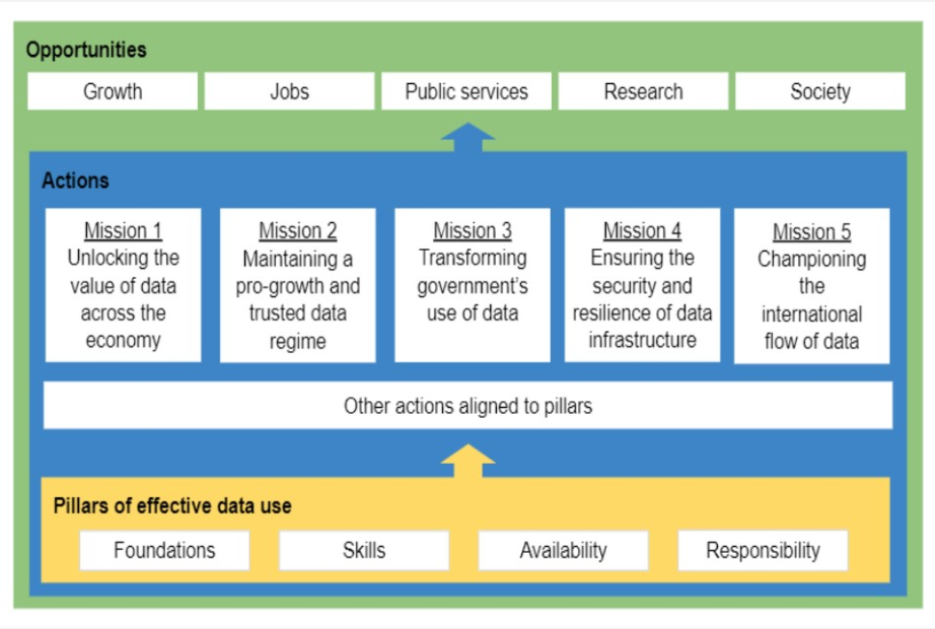
National Data Strategy

Slide 24
National Data strategy: Mission five: International flow of data
New and innovative mechanisms for international data transfers
Facilitate cross-border data flows
Remove unnecessary barriers to international data transfers
UK ‘data adequacy’ with global partners to promote the free flow of data to and from the UK

Slide 25
Adequacy
Article 45 UK GDPR and Section 17A of DPA 2018
Different approach?

Slide 26
Standard Contractual Clauses
Article 46 UK GDPR and section 17C DPA 2018 (Secretary of State)
Or
Article 46 UK GDPR and section 119A DPA 2018 (Commissioner)

Slide 27
What happens to Schrems II?
Retained case law
Section 6(3) and 6(6) – European Union (Withdrawal) Act 2018
Intention of the modification

Slide 28
Is it a solid foundation?
Forum for political dialogue
Head off difficulties
There may be a price to pay for the free flow of data
Risk of loss of UK’s EU adequacy

Slide 29
References
Beyond Brexit: trade in services. (n.d.). [online] . Available at: https://publications.parliament.uk/pa/ld5801/ldselect/ldeucom/248/248.pdf [Accessed 11 May 2021].
‌www.bsg.ox.ac.uk. (n.d.). The UK and digital trade: which way forward? [online] Available at: https://www.bsg.ox.ac.uk/research/publications/uk-and-digital-trade-which-way-forward [Accessed 11 May 2021].
Duhs, E. and Rao, I. (2021). Retained EU law : a practical guide. London: The Law Society
Erdos, D. (2021). The UK and the EU Personal Data Framework After Brexit: Another Switzerland? SSRN Electronic Journal, (15).
‌edps.europa.eu. (n.d.). Data protection is non-negotiable in international trade agreements | European Data Protection Supervisor. [online] Available at: https://edps.europa.eu/press-publications/press-news/press-releases/2021/data-protection-non-negotiable-international_en [Accessed 11 May 2021]
Peers, S. (2020). EU Law Analysis: Analysis 2 of the Brexit deal: EU/UK Trade and Cooperation Agreement – overview. [online] EU Law Analysis. Available at: https://eulawanalysis.blogspot.com/2020/12/analysis-2-of-brexit-deal-euuk-trade.html [Accessed 11 May 2021].
Recommendations 01/2020 on measures that supplement transfer tools to ensure compliance with the EU level of protection of personal data. (2020). [online] . Available at: https://edpb.europa.eu/sites/default/files/consultation/edpb_recommendations_202001_supplementarymeasurestransferstools_en.pdf Accessed 11 May 2021].‌
Yakovleva and Irion (2020), 'Pitching Trade against Privacy: Reconciling EU Governance of Personal Data Flows with External Trade', 10 International Data Privacy Law 201. At 211.
‌

