Slide 1
The populist challenge to constitutional citizenship
Jo Shaw
University of Edinburgh and Tampere University

Slide 2
Part of a book due to appear in early June 2020
https://bristoluniversitypress.co.uk/the-people-in-question
Notes:
Going to talk about constitutional citizenship. And populism. And how they interrelate. The closing of discursive space. And actions have consequences.

Slide 3
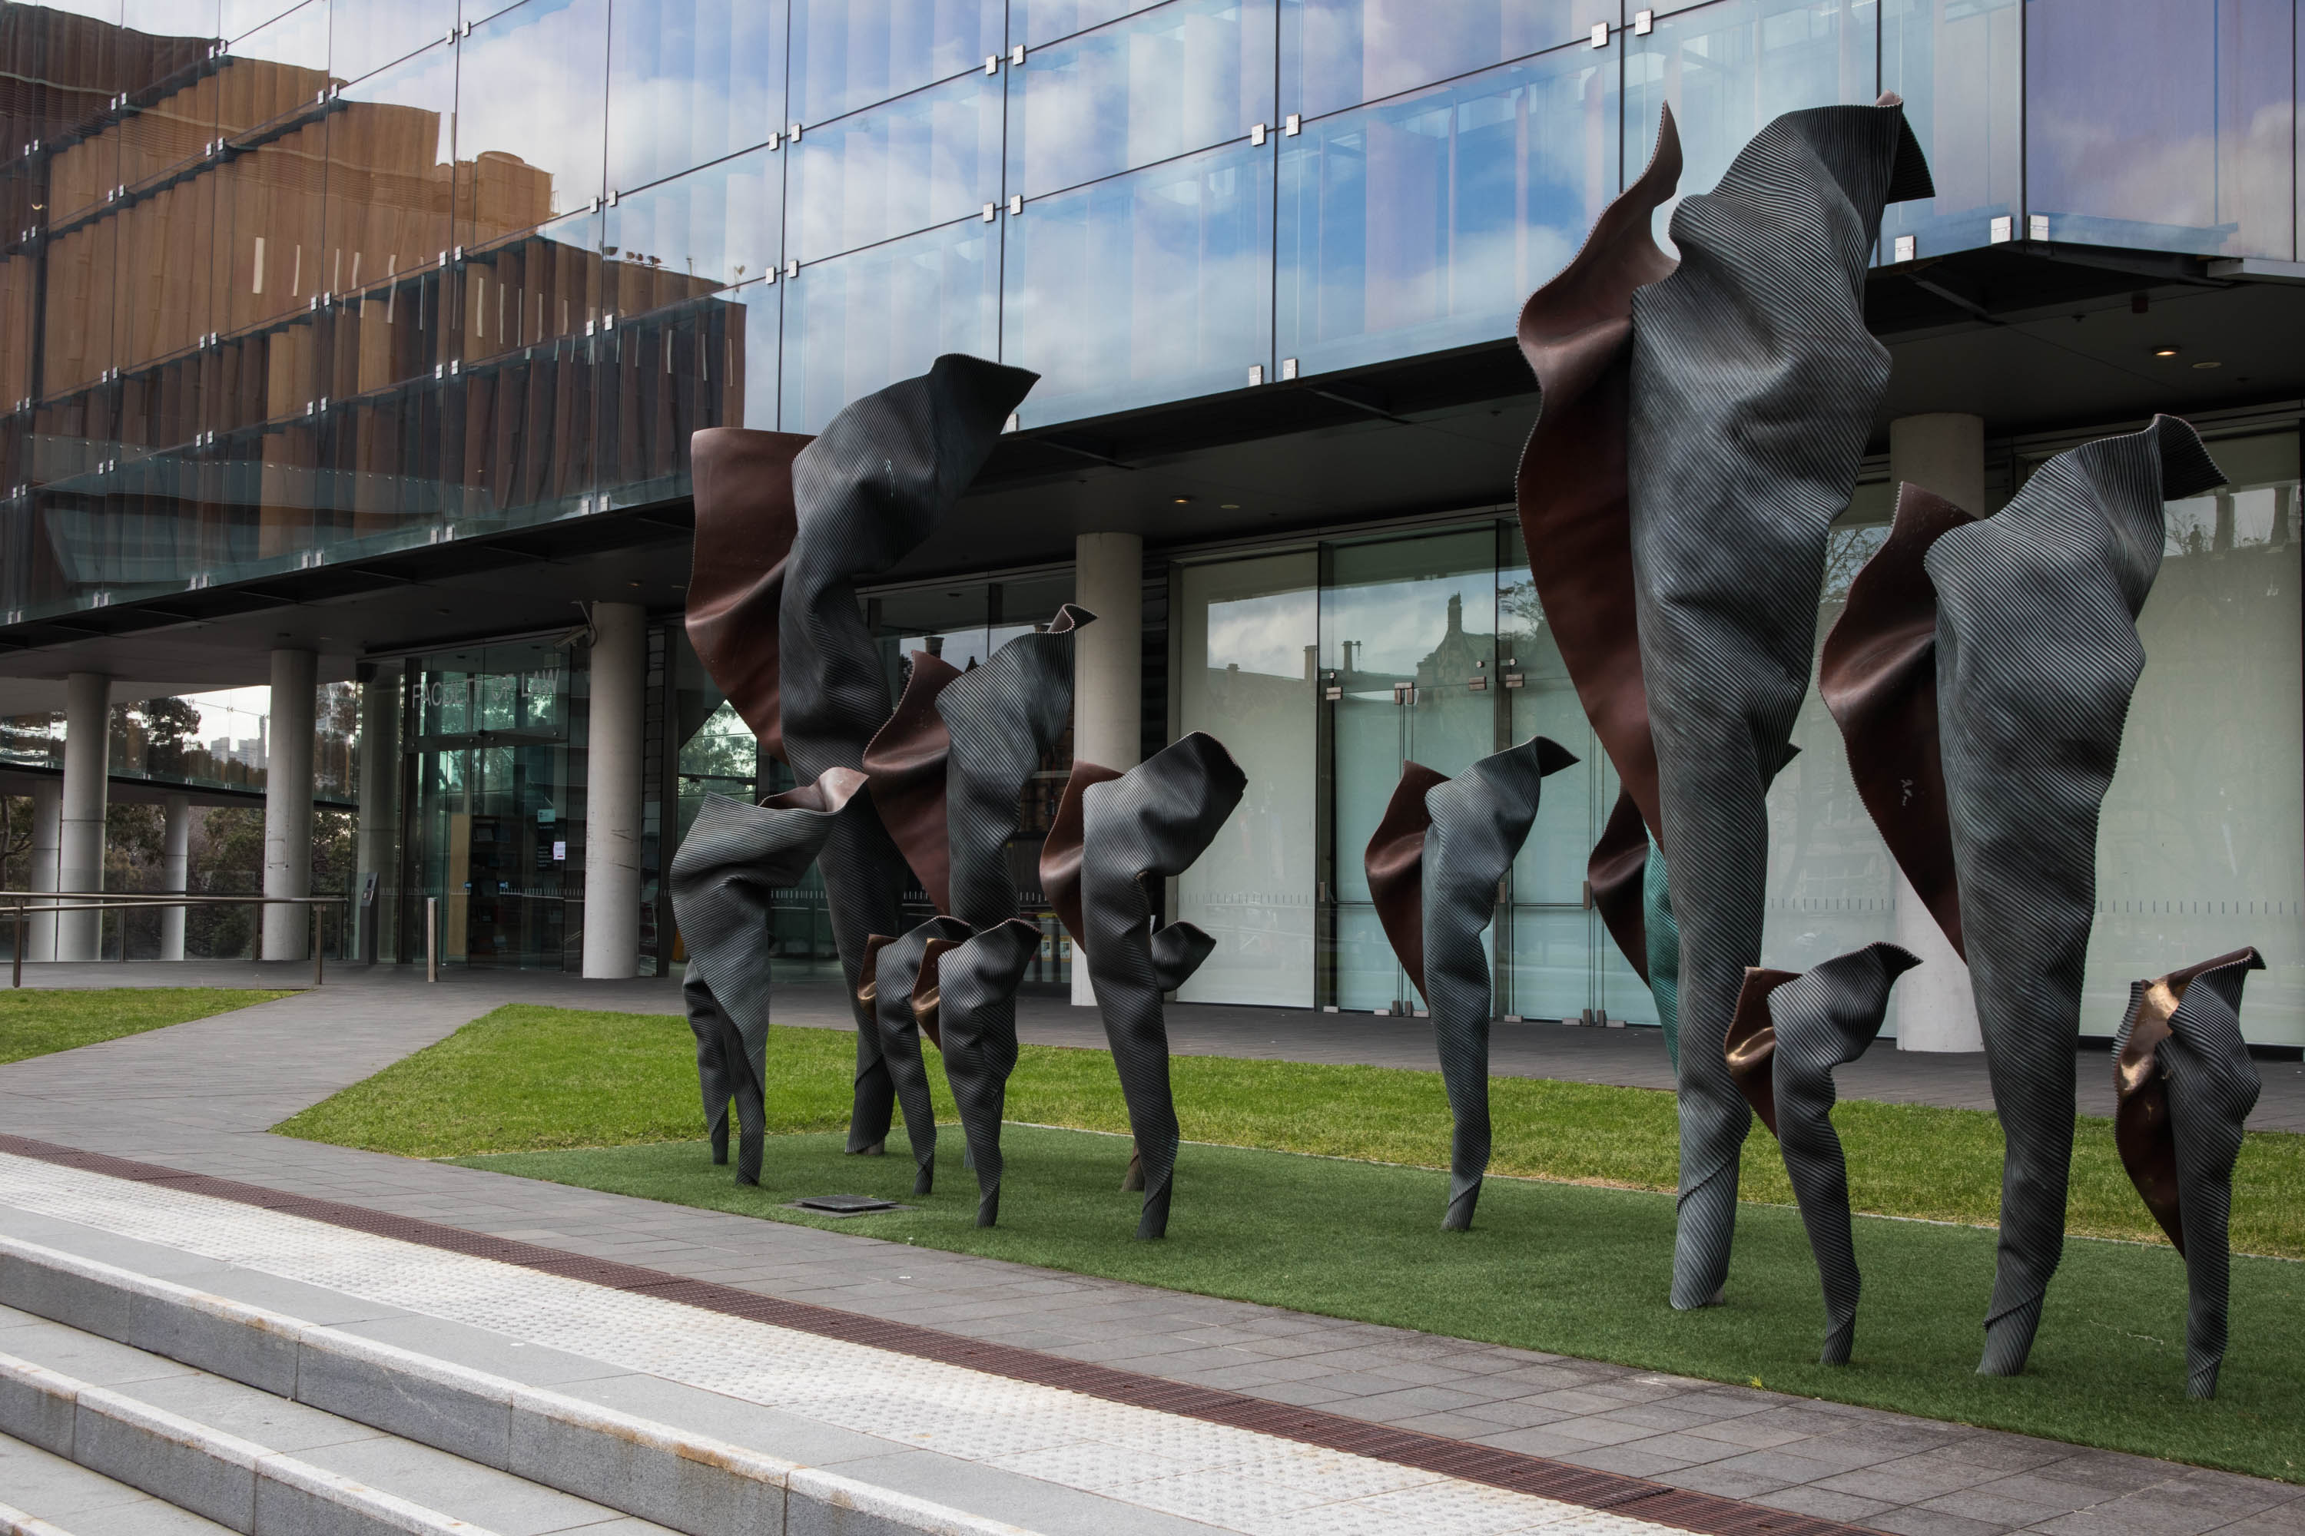

Slide 4
Citizens / Constitutions
Constitutional citizenship: often cited and rarely fully articulated
The conditions on which national citizenship is conferred, withheld or revoked are integral to the identity of the nation State. They touch the constitution; for they identify the constitution’s participants.
Lord Justice Laws in G1
Why study them together?
How to study them together?
Interpretation: involves choices e.g. about normative questions
Notes:
Those parts of the membership relation that go to the very heart of the polity and some of the conditions for the existence of that membership relation
it has focused on those matters relating to citizenship (such as status, rights, identity, etc.) which are not simple choices of ordinary politics or ordinary law, and which, precisely because they evolve over time, offer a set of messages about the essence of the polity and the principles and norms on which it is founded. The ‘unpacking process’ is, therefore, part observation and part interpretation, as highlighted in the methodological excursus at the end of Chapter 1. In the process of highlighting some examples of how citizenship and constitutions have interacted, we have also reflected back on the contested concepts of modern citizenship and constitutionalism, contributing in the process to the normative reconstruction of those concepts, initially in the context of the modern territorial state. This is most clearly shown in those sections of the chapter which observed that this relationship, while close, is not necessarily comfortable, highlighting that much of what we take for granted is based on a partial and westernised reading of citizenship (and indeed of constitutionalism and sovereignty). We will take this process much further in Part Two when we break the classical conception of citizenship down into its component parts for the purposes of excavating the tensions between in the citizenship / constitution relationship.

Slide 5
Populism and citizenship
Why populism?
Paired in the context of the book also with the shifting spatialities of citizenship
Populism as a style of politics that can operate to close down the discursive space in which citizens can operate as free and equal political agents
Shifting spatialities decisively challenge the singularity of the citizen/polity relationship
Notes:
Two particularly significant challenges to citizenship at the level of state or national constitutions stem from the political forces of populism and from trends towards globalisation and other ‘beyond the state’ dynamics. These challenges illustrate a variety of different ways in which the state-based model of constitutional citizenship has been put under pressure.
Populism is a style of politics that can operate to close down the discursive space within which citizens can operate as free and equal political agents. It can be said to eat away at those elements of the citizenship / constitutional law interaction which emphasise citizenship as a universal status, as a result of the populists’ appropriation of the notion of ‘the people’. It ramps up the split between the ideal of equality inherent in citizenship and the reality of a sharp divide between insiders and outsiders. Combined with other ideological stances such as nationalism, populism poses a threat to liberal democratic orders, and this can tear at the fabric of a conception of state-based citizenship premised on the ideal of equality.
Globalisation, meanwhile, describes the intensification of interactions or integration between countries, people and other actors such as companies, potentially without regard to the existence or disciplines of state borders and the legal orders within them. Globalisation challenges the citizenship / constitutional law interaction, because it puts into question the singularity of that relationship, pointing to multiple membership interactions between people and various legal orders at the national, supranational and international levels which need to be described and conceptualised. This pressure from above upon the state is often paired with pressure from below (the substate level), as well as horizontally from other state-level legal orders likewise simultaneously challenged by global forces. In that context, it seems better that our focus should be the broader topic of ‘the shifting spatialities of citizenship’ rather than just ‘the impact of globalisation on citizenship’. The fragmentation of governance arrangements is the watchword in this context. One of the most important questions that needs to be asked is whether any loss of autonomy or control at the national level in relation to the scope or quality of polity membership can be effectively compensated by reference to conditions for legitimate political action pertaining within the other legal orders. Or does the scenario of ‘citizenship beyond the state’ have an irresolvable democracy problem?
Populism and shifting spatialities are not parallel or even countervailing forces in the way that one might suggest ‘nationalism’ and ‘internationalism’ could be. They raise very different types of questions. There are distinct and obvious tensions between the two sets of ideas, not least because, as we shall discuss in Chapter 6, populist politics are in some respects a national reaction to what some would argue is the undemocratic liberalism of the international order that we will examine in Chapter 7.

Slide 6
Modi and Trump: Jason Stanley in The Guardian
https://www.theguardian.com/commentisfree/2020/feb/24/trump-modi-citizenship-politics-fascism

Slide 7
What’s different about the populist challenge to citizenship?
Looking for ‘the people’ in constitutional citizenship
Functions of ‘the people’ in
Citizenship
Constitution
The neglect of the ‘unitary collective particular’ (Neil Walker)
Public law in the era of populism cannot be defended in court; it must be defended in the streets (Julian Scholtes)
Specifically why a useful optic on the case of Hungary (and other cases such as UK/Brexit, US, Canada, India)

Slide 8
Populism and citizenship in Hungary
The importance of (liberal and ethnic) citizenship after 1989 – the paradox
Hungary’s delayed constitutional ‘revolution’ (since 2011)
Impact on citizenship: e.g. redefinition of the constitutional identity
Extension of external citizenship (and voting)
Aggressive constitutional politics – multiple constitutional amendments; wiping away of case law of the Constitutional Court
Asylum seekers and burden sharing – a European challenge
Decision of the Constitutional Court on the ‘Stop Soros’ laws (2019)

Slide 9
Orban’s populism as a ‘European game’
The greatest shift in Orbán’s (re)construction of “the people,” … came with the migration crisis. Instead of simply associating the Hungarians with “the people,” Orbán elevated “the people” into the European sphere of action. Hence, he identified “the people” first as “the European people” …, “we, Europeans” …, and “we, the peoples of Europe” (Robert Csehi)

Slide 10
Conclusions
We’re at a populist moment where we should be vigilant about stories of peoplehood (Brubaker)
Decisive erosion of the ideal of citizenship as based on equality and self-rule?
The challenges of judicial interventions in the sphere of citizenship: what type of output legitimacy can they bring?
And what of input legitimacy – the re-invigoration of democracy that some defenders of populism promise?

