Slide 1
DIGITAL EMPIRE OR DIGITAL FIEFDOMS?
INTRA-EU TENSIONS OVER THE RIGHT TO DATA PROTECTION
CELS Lunchtime Seminar
Prof Orla Lynskey (UCL), Dr Katherine Nolan (TU, Dublin) and Dr Maria Murphy (Maynooth University)
5 February 2025

Slide 2
THE DUAL OBJECTIVES OF DATA PROTECTION LAW
Fundamental Rights
Public good
Economic Value
Notes:
Raises questions about the margin of appreciation afforded to the Commission.

Slide 3
A RIGHTS-BASED REORIENTATION
Article 8 EU Charter: Protection of personal data
Everyone has the right to the protection of personal data concerning him or her.
2. Such data must be processed fairly for specified purposes and on the basis of the consent of the person concerned or some other legitimate basis laid down by law. Everyone has the right of access to data which has been collected concerning him or her, and the right to have it rectified.
3. Compliance with these rules shall be subject to control by an independent authority.

Slide 4
‘Constitutional dialogue’ between Commission and Court on substantive data protection requirements
Are intra-institutional dynamics recalibrating EU data protection law and how should the Court respond?

Slide 5
OVERVIEW
Adequacy: an introduction
An Empirical Analysis of Adequacy
Legitimacy and Intra-EU Contestation of Rights

Slide 6
ADEQUACY AND THE REGULATION OF TRANSNATIONAL DATA FLOWS

Slide 8
MECHANISMS TO ENSURE THIRD-COUNTRY TRANSFERS
Adequacy decisions (Art 45)
Contractual Mechanisms (Model Contract – Art 46 and Binding Corporate Rules – Art 47)
Derogations for specific situations (eg. Consent or contract, Art 49)

Slide 9
SCHREMS I: SUBSTANCE
“adequate” = not identical but “a level of protection… that is essentially equivalent” to that in EU
Requires a finding that legal order of third country “ensures” such a level of protection: based on content of rules; practice; and regular review
Commission: reduced discretion and strict standard of review

Slide 10
SCHREMS II
Level of protection offered must be assessed in light of the EU Charter [101]
Does the Privacy Shield comply with the GDPR read in light of the Charter?
Protection offered does not correlate to minimum safeguards in EU law [184]
No right to an effective legal remedy [192]
Suggests there will be no legal vacuum as Article 49 GDPR provides for alternatives [202].

Slide 11
Notes:
Stewart Baker describes the judgment as a “gobsmacking … mix of judicial imperialism and Eurocentric hypocrisy” and proposes that the U.S. use trade penalties to force the European Union to back down and make Europeans realize that the U.S. is serious about keeping “the right to write U.S. laws without getting permission from European governments.”

Slide 12
Commission decisions subject to a strict standard of review.
Prescriptive criteria set out by the Court to guide the adequacy assessment

Slide 13
AN EMPIRICAL ANALYSIS OF ADEQUACY

Slide 14
ADEQUACY DECISIONS
Andorra | Isle of Man
Argentina | Jersey
Canada (PIPEDA only) | New Zealand
Faroe Islands | Switzerland
Guernsey | Uruguay
Israel | US – Safe Harbor
Japan
Republic of Korea
UK
US – Privacy Shield
US – Data Privacy Framework
Shift in inter-institutional dynamics post-GDPR
Notes:
Clear disparity between the standards set by the Court and the standards applied by the Commission.

Slide 15
DATA PROTECTION - INSTITUTIONS
Court of Justice of the EU
(Court of Justice and General Court)
European Data Protection Board
(formerly Article 29 Working Party)
National Supervisory
Authorities
(DPAs)
EU Commission

Slide 16
MARGINALISED EXPERT INPUT
Directive: A29WP engaged directly with the state via their DPA (Faroe Islands; Hungary; Israel; New Zealand; Uruguay)
GDPR: the Commission provides information gathered to the EDPB for its opinion (Japan; Korea; UK; US)
Notes:
Criteria for the assessment of adequacy: criteria set in the ‘Adequacy Referential’ guidelines of the EDPB (WP12; WP254; WP257)

Slide 17
ENHANCED ROLE OF COMMISSION IN NEW DECISIONS
"However, following a careful analysis of the Commission’s draft adequacy decision as well as of the Japanese data protection framework, the EDPB notices that a number of concerns, coupled with the need for further clarifications, remain”.
Japan, para 30 and 55/56
Commission endorsed its ‘draft implementing decision’ on UK adequacy before initiating the procedure for its formal adoption, including by asking for the opinion of the EDPB on that date.

Slide 18
MARGINALISED ROLE OF EDPB IN ADEQUACY REVIEW
“At the same time, the EDPB notes that the information provided in the SWD is not as detailed as in the context of a draft adequacy decision submitted to the EDPB for its opinion as per Article 70(1)(s) GDPR. In addition, as mentioned above, the EDPB was not formally consulted by the Commission since no adequacy decision was repealed, amended or suspended.”
“The EDPB stands ready to be involved in the next periodic review of the eleven adequacy decisions adopted under the Directive 95/46/EC, as the EDPB does for all the periodic reviews of adequacy decisions adopted under the GDPR.”

Slide 19
QUESTIONABLE COMPLIANCE WITH JUDICIAL GUIDANCE
The EDPB is not in a position to fully assess the implementation of necessity and proportionality in practice and highlights the need to continue to carefully monitor this aspect, including in future reviews of the DPF.” [para 29-30]
Notes previous concerns to bulk access without prior authorization:
“The first periodic review did not provide any new information or developments that affect the EDPB’s previous analysis in this respect. The EDPB therefore maintains its concern as raised at the time. Moreover, the EDPB considers that recent case law of the ECtHR further supports its standpoint, as the Court has once again emphasized the importance of independent prior authorisation of secret surveillance measures.” (para 37)

Slide 20
OUT OF KILTER WITH THE EDPB AND COURT
The standard contractual clauses may be used for such transfers only to the extent that the processing by the importer does not fall within the scope of Regulation (EU) 2016/679.
SCC DECISION, para 7.
The Principles apply solely to the processing of personal data by the U.S. organisation in as far as processing by such organisations does not fall within the scope of Union legislation.
Privacy Shield, recital 15
Notes:
Moreover, Christopher Kuner reports that “the Commission has indicated that it is likely to insert language in adequacy decisions mirroring that used in the SCCs, i.e. indications that an adequacy decision does not apply to transfers to a data importer whose processing of the data is directly subject to the GDPR.”
Christopher Kuner, ‘Protecting EU data outside EU borders under the GDPR’ (2023) 60(1) Common Market Law Review 77, p. 93.

Slide 21
OUT OF KILTER WITH THE EDPB AND COURT
Three cumulative criteria to qualify a processing operation as a transfer:
A controller or a processor (“exporter”) is subject to the GDPR for the given processing.
The exporter discloses by transmission or otherwise makes personal data available to another controller, joint controller or processor (“importer”).
The importer is in a third country.
European Data Protection Board Guidelines, 05/2021
Repeated by Court in T-354/22 Bindl v Commission, paras 186-188.

Slide 22
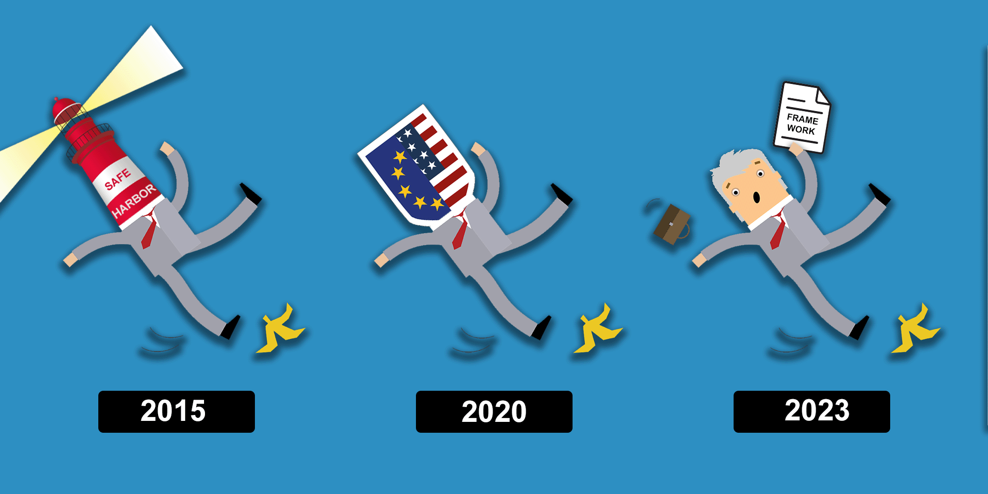
No/limited role for the EDPB in adequacy review and marginalized in adoption of new decisions
Selective approach to ECtHR and CJEU ‘criteria’
A more political approach to data protection law as a challenge to the Court’s authority?

Slide 23
NEW SITES OF INTRA-EU HUMAN RIGHTS CONTESTATION

Slide 24
CONFIGURATIONS OF HUMAN RIGHTS REVIEW
Vertical dialogue (with Member States)
Horizontal dialogue (with the EU legislature)
Horizontal dialogue (with the Commission)?

Slide 25
NEW HORIZONTAL TENSIONS?
“…rather than being an ‘end point’ adequacy decisions have laid the foundation for closer cooperation and further regulatory convergence between the EU and like-minded partners. By enabling the free flow of personal data, these decisions have opened up commercial channels for EU operators, including by complementing and amplifying the benefits of trade agreements, as well as eased cooperation with foreign partners in a broad range of regulatory fields.”
Commission, Report on the first review of adequacy decisions, 2/3

Slide 26
NEW HORIZONTAL TENSIONS?
‘the rule of law is not up for sale. It is a matter of upholding the requirements in the European Union, of the rule of law, of fundamental rights. If this is also affecting some dealings internationally, why would Europe not be proud to contribute its requiring standards of respect for fundamental rights to the world in general?’
Lenaerts

Slide 27
APPROPRIATE STANDARD OF REVIEW?
The interpretation of Charter rights may well be contestable and there will inevitably be cases in which the Union courts substitute their view for that of the legislature on the meaning and interpretation of such a right. The counter-majoritarian aspect of constitutional review will therefore be more apparent than hitherto.
Craig
Contrast: standard of review to cases where the Commission makes complex economic and social appraisals.

Slide 28
STANDARD OF REVIEW/MARGIN OF APPRECIATION
The same normative criteria would also explain the strict review operated in Schrems. As an implementing act, the Court of Justice in Schrems invalidated a political decision of the EU institutions, but one adopted by a body (the Commission) with weak political accountability and limited responsiveness to EU citizens. In this decision-making process, neither of the Union’s legislative institutions was present (with one, the EP, being critical of the Commission’s action).
Muir
Marginalisation of EDPB adds to the legitimacy of strict review

Slide 29
LESSONS FOR THE FUTURE
Court should continue to exercise strict review of Commission adequacy decisions → legitimacy challenge if Commission continues to deviate
Review of other legislative instruments recalibrating balance between fundamental rights and societal interests in data processing should be more deferential

Slide 30
Feedback welcome
o.lynskey@ucl.ac.uk

