Slide 1
EU Fiscal Policy in the Midst of the Pandemic or Should the exception become the rule?
Antonio Estella
Jean Monnet Chair “ad personam” in Law of EU Economic Governance
UC3M

Slide 2
The EU’s fiscal response to the covid crisis:
- Has two main prongs:
Fiscal impulse (750 billion)
Freezing of the Stability and Growth Pact

Slide 3
Both aspects are of course interlinked. As a matter of fact, I will go to the second one (SGP freezing) through the first one (fiscal stimulus), as a way to give some systematic to my presentation.

Slide 4
We know about the first one, but let us remember a couple of basic points

Slide 5
As regards the second one (freezing), the Commission proposed to freeze the SGP here:

Slide 6
Which, in turn, the ECOFIN endorsed, here:

Slide 7
The “bridge” between the stimulus package and the freezing of the SGP is given in article 10 of regulation 2021/241 “establishing the Recovery and Resilience Facility”

Slide 8
As has been seen, the Council has determined the existence of an exception, so therefore both commitments and payments could not be suspended at least for the reason of a Member State incurring in an excessive deficit

Slide 9
Member State | Government Deficit 2020 (planned by Com) | Situation
Italy | 11,10% | ED-exception
UK | 10,70% | (ED)-(exception)
Spain | 10,30% | ED-exception
Estonia | 10,10% | ED-exception
France | 9,90% | ED-exception
Poland | 9,50% | ED-exception
Slovakia | 8,50% | ED-exception
Austria | 8% | ED-exception
Denmark | 8% | ED-exception
Belgium | 7,50% | ED-exception
Latvia | 7,30% | ED-exception
Finland | 7,20% | ED-exception
Slovenia | 7,20% | ED-exception
Germany | 7% | ED-exception
Lithuania | 6,90% | ED-exception
Croatia | 6,80% | ED-exception
Malta | 6,70% | ED-exception
Portugal | 6,50% | ED-exception
Greece | 6,40% | ED-exception
Holland | 6,30% | ED-exception
Ireland | 5,60% | ED-exception
Sweden | 5,60% | ED-exception
Hungary | 5,20% | ED-exception
Czechia | 5,10% | ED-exception
Luxembourg | 4,80% | ED-exception
Cyprus | 4,30% | ED-exception
Bulgaria | 3,10% | ED-exception

Slide 10
Bottom line
All the Member States have been granted an exception, except for Romania, for which there is still an ongoing EDP

Slide 11
Exceptions
1) Which are these
2) Genesis
3) Interpretations
4) Implications for law as credibility

Slide 12
What are the exceptions?

Slide 13
Genesis
Not in original 1466/97 and 1467/97
Not in the 2005 reforms
But in the 2011 reforms (six pack).
So, introduced via:
Regulation 1175/2011 (as regards the 1466/97 exceptions)
And regulation 1177/2011 (as regards the 1467/97 exceptions)

Slide 14
Bottom line-criterion:
“Severe economic downturn in the euro-area or the Union as a whole”
But (and this “but” is important)
There is another criterion that has been overlooked in the current crisis:
“unsual event outside the control of the Member State concerned having a major impact on the financial position of the general government”

Slide 15
Interpretations
The interpretation that has been given by the Commission is that the first criterion applies to the whole of the euro-area or the Union and is equivalent to the so-called “general escape clause” (EC, Communications of 13 March 2020 and 20 March 2020).
The second criterion would be only applicable to individual Member States.

Slide 16
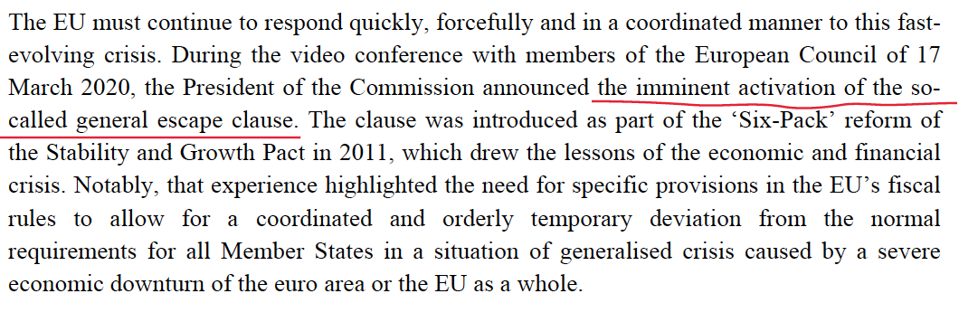
Interpreting the exceptions: 3 steps (EC, 20 March 2020)

Slide 17
Unclear aspects
Why Romania has then not been granted an exception?
What is an event outside the control of a Member State? What is the difference between this criterion and the criterion “severe…”
And, more importantly: how to assess that we are before of a severe economic downturn in the euro area of the Union as a whole?

Slide 18
The debate between rules versus discretion re-emerges here again, as regards the “severe…” criterion
The European Commission has been careful not to define this criterion when it has requested the activation of the escape clause to the Council
In turn, the Council has just confirmed that we are before a severe economic downturn, without measuring it
However, other actors are pressing for a more rules-based approach.
This is the case of the European Fiscal Board, for example.
The EFB:
attempts to quantify what a severe economic downturn is
advocates for the deactivation of the escape clause as soon as the severe economic downturn is over
advocates for a sunset clause to be put on the top of the escape clause.
(https://ec.europa.eu/info/sites/info/files/2020_06_25_efb_assessment_of_euro_area_fiscal_stance_en.pdf)

Slide 19
However, it also says that (and this however is an important one)
“Progress towards a genuine central fiscal capacity focusing on the protection of growth enhancing government expenditure makes the return to a rules-based EU framework for national fiscal policies a natural complement”

Slide 20
I couldn´t agree more with this statement

Slide 21
This makes me go to the final point of this talk, the connection between exceptions and problems of credibility
What was awkward from the perspective of credibility was to expect that a rules-based approach would be implemented in the absence of a “central fiscal capacity” (a Fiscal Union).
With a strong central fiscal capacity, the EU could demand fiscal discipline to its Member States in exchange of fiscal support
Without a strong central fiscal capacity it was not credible to think that the Member States would rigidly stick to the SGP and that the sanctions system enshrined therein would be implemented. This is, in fact what happened. Reality tried to conform to law (but it couldn´t)
In my opinion, the debate on exceptions to the SGP offers an opportunity to modify the EU fiscal system and go to an open method of coordination-like system.
Rules would become desirable targets
that would, as the case may be, unfold a process of naming and shaming.
This should be taken into account by the European Commission in the current process of review of EU economic governance.
This would do until a strong central capacity would be established in the EU edifice of economic governance
Going to a OMC-like system would produce gains from the perspective of credibility and law as credibility:
as for the first, the non-implementation of the sanctions system (for example), as a consequence of the turn to an open method of coordination-like system, would no longer be a problem, and markets would welcome this development;
from the perspective of law as credibility, the credibility of the law would be restored, since the system would fly away from a rules-based approach and would be more discretionary (this is what happens today, as a matter of fact). Law and reality would go hand in hand.

Slide 22
So yes: the exception should in my opinion become the rule, unless the EU decided to create a strong fiscal central instrument to combat crises (at the minimum).

Slide 23
Thanks

