Slide 1
What is EU Relations Law? The Legal Ecosystem after Brexit
Jack Williams
Barrister
Monckton Chambers

Slide 2
Timeline
Exit day
Negotiations
Implementation legislation
IPC day
Activate global free trade deals
Amend any pesky retained EU law
FTA agreed?
Internal affairs legislation passed
EU Relations Law commences
transition/implementation period a mini transition?
period

Slide 3
EU Relations Law (EURL): The Legal Ecosystem (1)
Institutional framework
EURL
Retention
Withdrawal
New relationship
Internal affairs
International agreements
EU law
Domestic law incl. devolution arrangements

Slide 4
EU Relations Law (EURL): The Legal Ecosystem (II)
Retention
EU law
(pre IPC day)
New relationship
FTA?
Internal affairs
Withdrawal
Internal Market Act
Trade Act
Immigration Act
Fisheries Act
Agriculture Act
Environment Act
Finance Act
Private International Law Act
New Act
EU(W)A 2018
Delegated legislation
WA & NI Protocol
EU(WA)A 2020
Delegated legislation
Delegated legislation

Slide 5
EU Relations Law (EURL): The Legal Ecosystem (III)
Retention
EU law
(pre IPC day)
New relationship
FTA?
Internal affairs
Withdrawal
Internal Market Act
Trade Act
Immigration Act
Fisheries Act
Agriculture Act
Environment Act
Finance Act
Private International Law Act
New Act
EU(W)A 2018
Delegated legislation
WA & NI Protocol
EU(WA)A 2020
Delegated legislation
Delegated legislation

Slide 6
EU Relations Law (EURL): The Legal Ecosystem (IV)
Retention
EU law
(pre IPC day)
New relationship
FTA?
Internal affairs
Withdrawal
Internal Market Act
Trade Act
Immigration Act
Fisheries Act
Agriculture Act
Environment Act
Finance Act
Private International Law Act
New Act(s)
EU(W)A 2018
Delegated legislation
WA & NI Protocol
EU(WA)A 2020
Delegated legislation
Delegated legislation

Slide 7
Regulations – proceed with caution
Deficiency amendments
Withdrawal amendments
New relationship amendments
An example
The Competition (Amendment etc.) (EU Exit) Regulations 2019
The Competition (Amendment etc.) (EU Exit) Regulations (No 2) 2019
The Competition (Amendment etc.) (EU Exit) Regulations 2020
[ ??? The Competition (Amendment etc.) (EU Exit) (No 2) Regulations 2020/2021 ??? ]

Slide 8
EU Relations Law (EURL): The Legal Ecosystem (V)
Retention
EU law
(pre IPC day)
New relationship
FTA?
Internal affairs
Withdrawal
Internal Market Act
Trade Act
Immigration Act
Fisheries Act
Agriculture Act
Environment Act
Finance Act
Private International Law Act
New Act(s)
EU(W)A 2018
Delegated legislation
WA & NI Protocol
EU(WA)A 2020
Delegated legislation
Delegated legislation
Devolved legislation

Slide 9
Staged questions
What is the international source?
EU law
Withdrawal Agreement / NI Protocol
FTA
How is it incorporated into domestic law?
Is it retained EU law? If so, what kind of retained EU law?
Does domestic law incorporate it or allow ‘specific and limited breaches’?
Has it been amended by domestic regulations? (and re-amended?)
Are there different devolved positions?
What are the remedies? (e.g. Francovich + validity?)

Slide 10
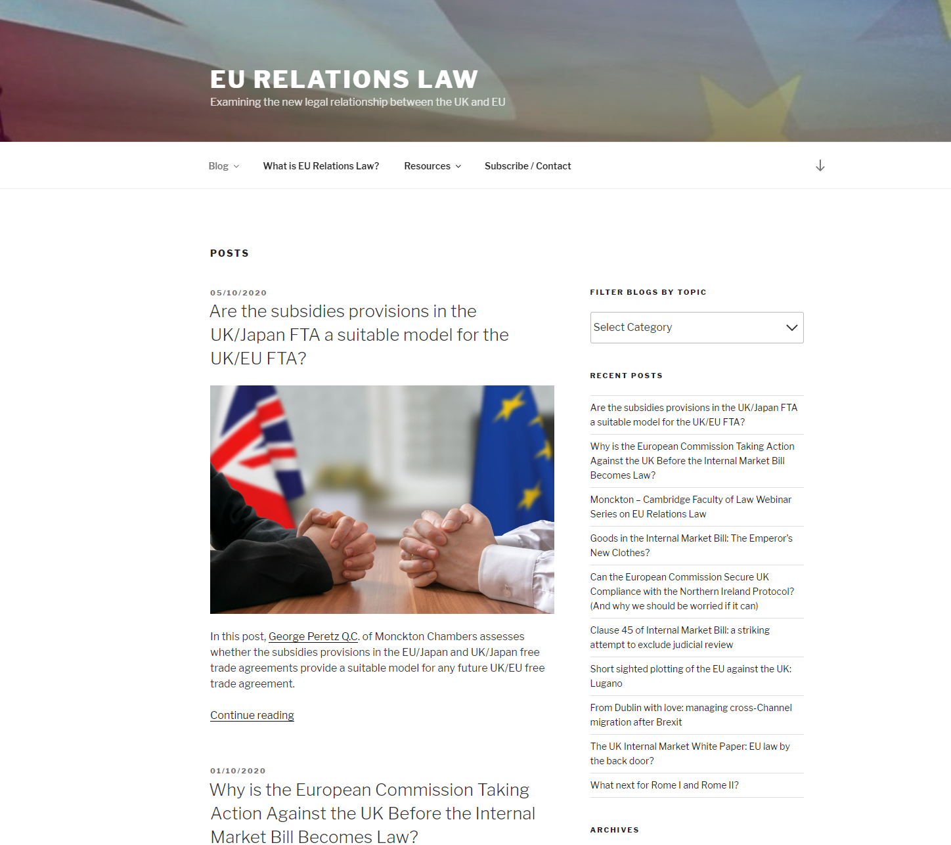
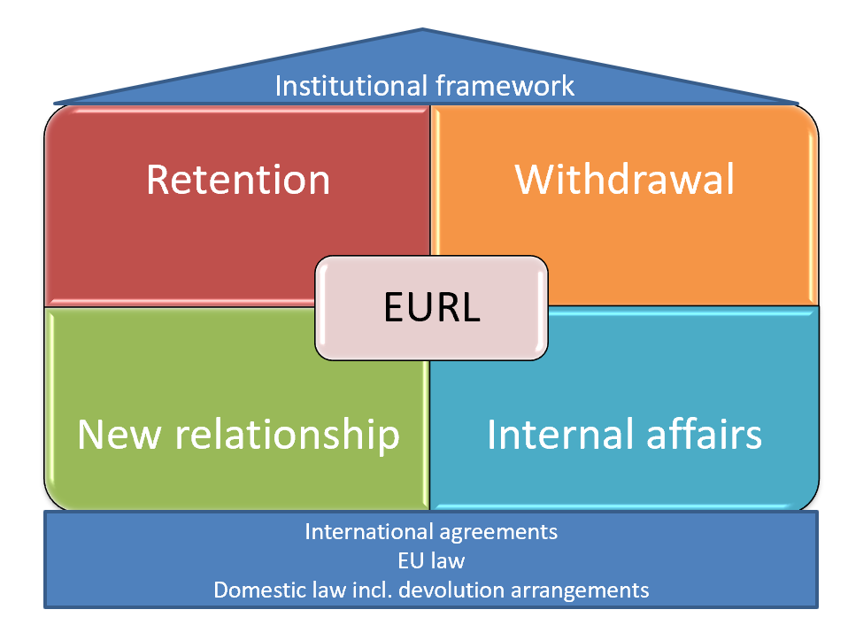
www.eurelationslaw.com

Slide 11
What is EU Relations Law? The Legal Ecosystem after Brexit
Jack Williams
Barrister
Monckton Chambers

