Slide 1
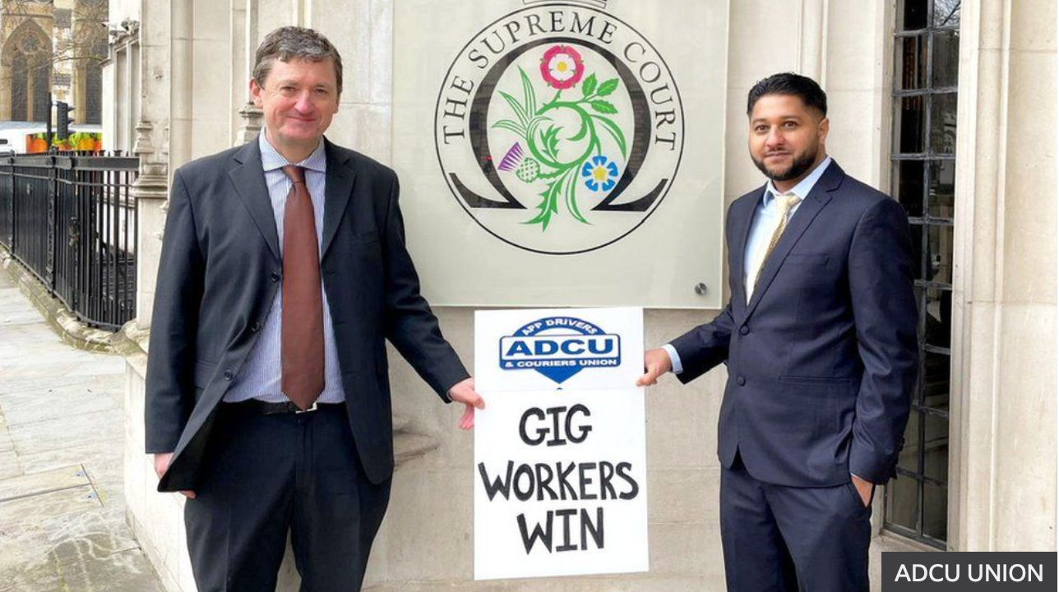

Slide 2
Most Scope for Critical Intervention by Labour Law Academics
SIGNIFICANCE
Uber
(These claimants)
The Gig-Economy
Persons in a comparable position to the claimants working for similar companies
Workers in General
Uber
Others working for Uber today/in the future

Slide 3

“Statutory Worker Test”
A reflection on the nature of the employment status question

Slide 4
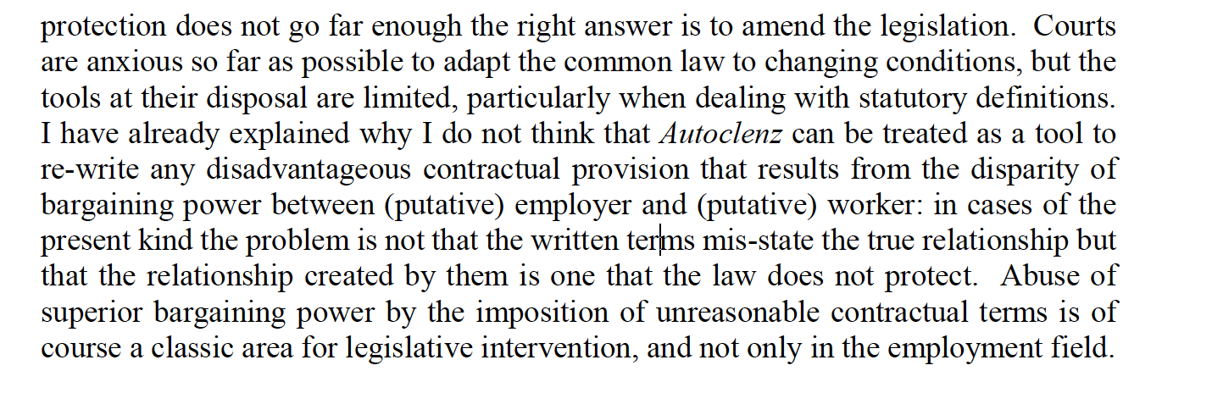
Per Lord Justice Underhill in the Court of Appeal at [164]

Slide 5
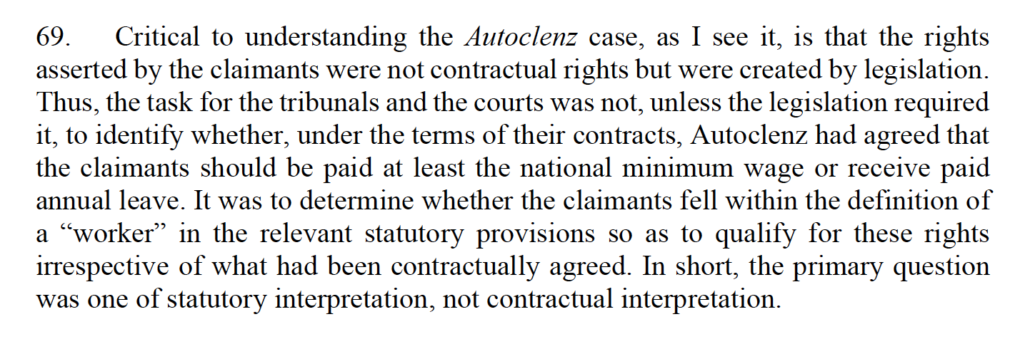
Uber Bv v Aslam, SC

Slide 6
But what is the source of this vulnerability?
Class structures
Vs
The nature of the legal relationship brought into being between the parties?

Slide 7
Key Questions
Control as evidence of structural subordination and dependence OR Control as something that gives rise to subordination and dependence?
Inequality of bargaining power allows employers to misrepresent the nature of the legal relationship brought into being by the parties OR Capital’s social power over labour allows employers to decide the legal arrangements through which labour power will be contracted.
Worker as a legal status describing a legal relationship brought into being by the parties OR Worker as a socio-economic status given legal significance for various regulatory purposes
Do we want a fragmentation of the ‘worker’ concept across legal regimes?

Slide 8
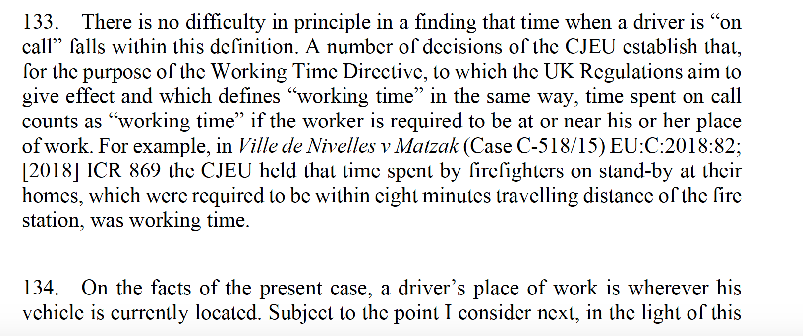
2. Working Time Regulations
Uber drivers are working even when they have the app switched on, and have not accepted, or embarked upon, any trips
But: limited rationale:

Slide 9
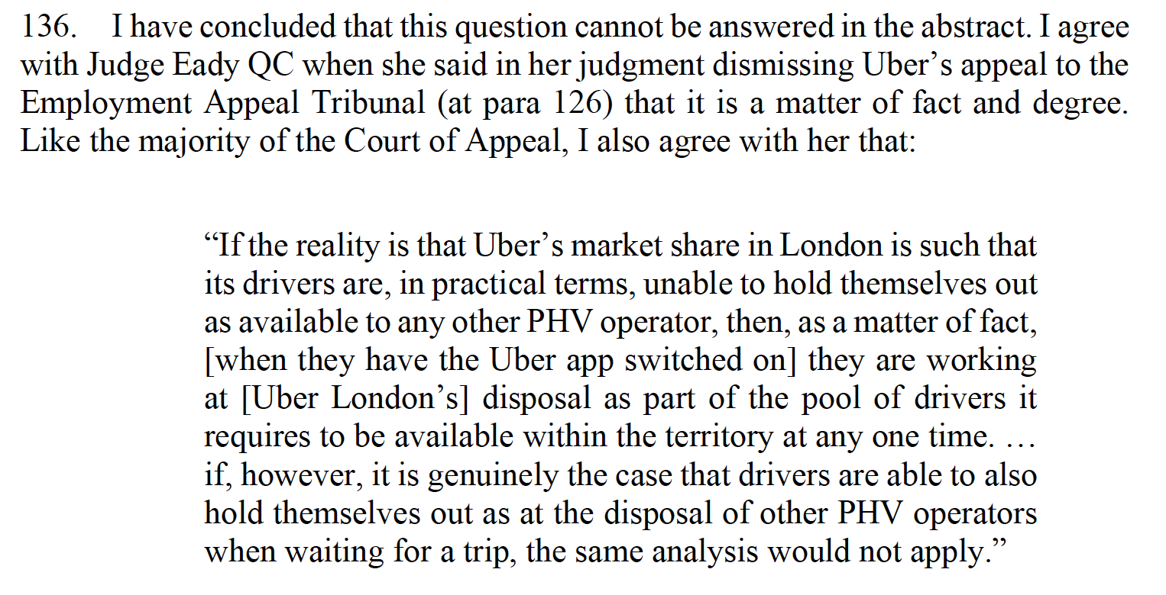
Potential/Opportunity
Recognition that compulsion and constraint can emerge from economic factors and labour market pressures

