Slide 1

A Doctrine of Pre-emption for the European Union
Amedeo Arena • University of Naples “Federico II”
University of Cambridge • 13 February 2019

Slide 2
I. EU pre-emption: notion and rationale

Slide 3

What is pre-emption?
A Theory of Normative Conflict
  Determines when EU law is in conflict with MS law
  So that primacy can solve the conflict
  Indicator of the residual law-making and treaty-making power of MS
Never explicitly endorsed by the ECJ
  But mentioned since 2009 by AGs Colomer, Jääskinen, Mengozzi, Sharpston, Szpunar, & Bobek

Slide 4

Why do we need pre-emption?
Other federal systems have a normative conflict theory (e.g. USA, Canada, Australia, Andean Com.)
Lack of an equivalent theory in the EU:
  makes application of primacy unpredictable
  makes national residual powers difficult to determine on the basis of the current conceptual framework

Slide 5

Normative conflicts in other federal systems
United States of America
Supremacy Clause (Article VI, Clause 2)
Doctrine of Federal Pre-emption
Classic version: latent exclusivity (Winfield, 1917; S. Railway, 1905)
Modern version (Gade, 1992):
  Presumption against (Rice, 1947)
  Express / Implied Pre-emption
    Field Pre-emption
    Conflict Pre-emption (Pacific Gas, 1983)
      Rule (direct conflict) pre-emption
      Obstacle (purposes) pre-emption

Slide 6
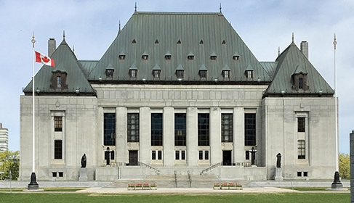
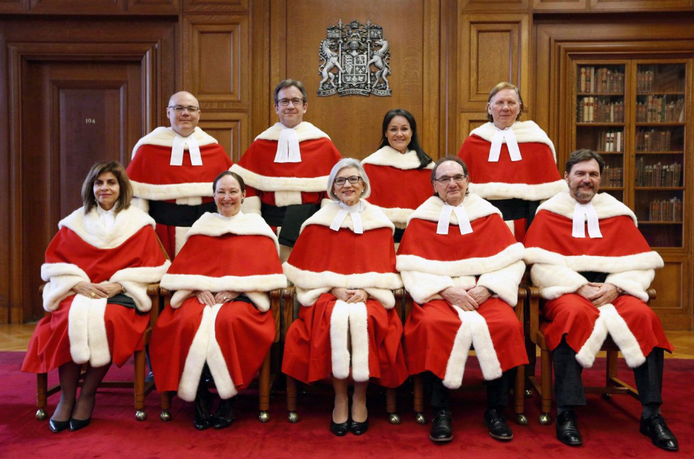
Normative conflicts in other federal systems
Canada
Paramountcy Doctrine
(Occupying the field) (Privy Council, Grand Trunk, 1906)
Two-branch test (SCC, Paramountcy Trilogy, 2015):
  Operational conflict
  Frustration of purpose

Slide 7

Normative conflicts in other federal systems
Australia
§ 109 Const. (Supremacy)
Covering the field test (HCA, General motors, 1977)
Conferred rights test (HCA, Colvin, 1943)
Simultaneous obedience test (HCA, Brisbane, 1920)

Slide 8


Normative conflicts in other federal systems
Andean Community
Preeminencia doctrine (1-IP-87)
Preemtion Andina (ATJ, 2-IP-88)
  Complemento indispensable
  Desarrollo legislativo ulterior

Slide 9

Primacy’s Unpredictability: Wilson

Slide 10

Primacy’s Unpredictability: Wilson

Slide 11

Primacy’s Unpredictability: Wilson

Slide 12

Primacy’s Unpredictability: Wilson

Slide 13
Aporias of the current framework
How should Wilson be accounted for?
  Is it the consequence of the primacy of Dir. 98/5?
  Is it the effect of shared competence under Art. 2(2) TFEU (cf. exclusivity by exercise)?
    But what about Protocol no. 25? (Cf. Melloni, Plus, etc.)
    Do Art. 2(5) TFEU and Art. 3(3)-(4) TFEU really matter?
  Is it the negative aspect of loyalty under Art. 4(3) TEU?

Slide 14
Aporias of the current framework
How should a priori exclusivity be accounted for?
  If encroachment on a given subject-matter is sufficient to trigger exclusivity, why does the ECJ look at conflicts with EU legislation adopted that area?
  How come a (legislative) «specific authorisation» can rule out (constitutional) «exclusivity»?
  Is it the consequence of the primacy of Art. 2(1) TFEU in conjunction with Art. 3(1) TFEU ?
  Is the negative aspect of loyalty under Art. 4(3) TEU?

Slide 15
Aporias of the current framework
How should ERTA be accounted for?
  Is it the (reversible) effect of the primacy of the «affected» common rules?
  Is it the (irreversible) effect of subsequent exclusivity under Art. 3(2) TFEU?
  Is it the negative aspect of loyalty under Art. 4(3) TEU?

Slide 16
Pre-emption as EU’s
Grand Unification Theory?
Accounts for the three main forms of preclusion
Inferred from ECJ case-law
Enables comparisons and shows common patterns between preclusion in various domains
Exclusivity
Primacy
Loyalty

Slide 17

Sources of EU Pre-emption
Constitutional Pre-emption
  EU Primary law and MS internal & external acts (inc. inter se agreements)
ERTA Pre-emption
  EU internal acts and MS external acts (inc. inter se agreements)
Legislative Pre-emption
  EU internal & external acts v. MS internal acts

Slide 18
Types of EU Pre-emption
Scope Overlap Test
  Comparision between the scope of the EU and the national norm
Field pre-emption
  Duty of abstention arises from a feature of the area occupied by the EU norm
Conflict pre-emption
  Duty of abstention arises from a conflict with EU provisions
S.O.T.
✗
✓
Fi.Pr.
✗
✓
Pre-emption
No Pre-emption
Co.Pr.
✓
✗

Slide 19
II. LEGISLATIVE pre-emption

Slide 20
Legislative Pre-emption: Overview
Scope overlap test
  + Positive
  Negative
Field pre-emption
  + Exhaustiveness
  – Minimum Harmonisation
  – Partial Harmonisation
  Conflict pre-emption
    Rule pre-emption
    Obstacle pre-emption

Slide 21
Legislative Pre-emption:
Scope overlap test
Usually ECJ only reports negative outcomes
Very important in legislative field pre-emption cases
Positive
  e.g. Cindu Chemicals: chemicals are subject to Dir. 76/769
Negative
  E.g. Amsterdam Bulb: products lie outside flowers CMO
EU act
MS act
EU act
MS act

Slide 22
Legislative Pre-emption
Field Preemption → Exhaustiveness
    E.g. Wilson
      Dir. 98/5 completely harmonised entry requirements
      Absence of prior tests is accompained by arrangements to protect consumers and the proper administration of justice
    E.g. Melloni
      The EAW FD carried out a(n exhaustive) ‘harmonisation of the conditions of execution of an EAW in the event of a conviction rendered in absentia’
      Making surrender conditional upon further requirements would undermine the EU FR protection standard that reflects the consensus of all the MS

Slide 23


Legislative Pre-emption
Field Preemption → Minimum harmonisation
      E.g. Hans Hoenig
        Dir. 88/166 set the minimum size of hen cages
        MS could require bigger cages
      E.g. Sky Italia
        Dir. 2010/13 set minimum rules on TV advertising
        MS could impose stricter limits on Pay-TV

Slide 24

Legislative Pre-emption
Field Preemption → Partial harmonisation
      E.g. De Agostini
        Dir. 89/552 partially harmonised TV advertising
        MS could regulate deceptive advertising
      E.g. Amatori
        Dir. 2001/23 protected workers in the event of transfers of undertakings
        MS could lay down rules to protect workers in the event of transfers of parts of undertakings

Slide 25

Legislative Pre-emption
Field Preemption → Type of act?
      Article 288 TFEU suggests that regulations have broader pre-emptive effects than directives
      Yet complete harmonisation directives (e.g. 98/5) have broader pre-emptive effects than minimum harmonisation regulations (e.g. for common wheat)

Slide 26
III. ERTA pre-emption

Slide 27
ERTA Pre-emption: Overview
Scope overlap test
  + (Quasi) Positive
  (Quasi) Negative
Field pre-emption
  + NMC Provisions
  + Scope Alteration
  + Exhaustiveness
  – Minimum Harmonisation
  – Partial Harmonisation
  Conflict pre-emption
    Rule pre-emption
    Obstacle pre-emption

Slide 28
ERTA Pre-emption:
Scope overlap test
Prospective assessment
  of EU law (Op. 1/13 Child Abduction)
  of MS act (Green Network)
Positive: «falls within the scope» (ERTA)
Quasi Positive: is «largely covered» (Op. 1/03 Lugano)
Negative: doesn’t «fall in an area covered» (Open skies)
Quasi-Negative: covers only «a very small part» (Op. 2/00 Cartagena)
EU act
MS
treaty
EU act
MS
treaty

Slide 29

ERTA Pre-emption:
Field Pre-emption → NMC Provisions
    Art. 3(2) TFEU, 1st part (WTO doctrine Op. 1/94). MS extenal action is preempted when EU act empowers EU institutions to enter agreements with NMC
    E.g. ERTA: reg. 543/69 empowered Council to negotiate agreements with NMC concerning road safety

Slide 30
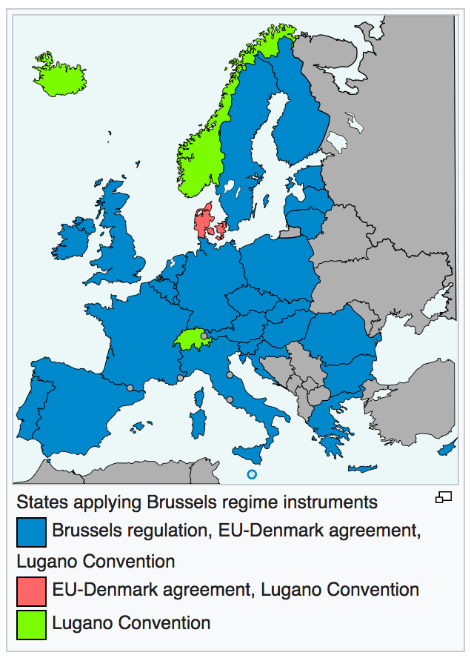
ERTA Pre-emption:
Field Pre-emption → Scope alteration
    Art. 3(2) TFEU, agreement may «alter the scope» of the common rules
    E.g. Opinion 1/03
      The Lugano Convention would «enlarge the scope of recognition of judicial decisions without any special procedure, thus increasing the number of cases in which judgments delivered by NMC courts can be recognised.

Slide 31

ERTA Pre-emption
Field Preemption → Exhaustiveness
    Art. 3(2) TFEU, agreement «may affect common rules»
    E.g. Opinion 2/91
      the legislature adopted directives laying down «very detailed» rules on the labelling of dangerous substances and preparations, pursuing «an ever greater degree of harmonization» of MS laws.

Slide 32
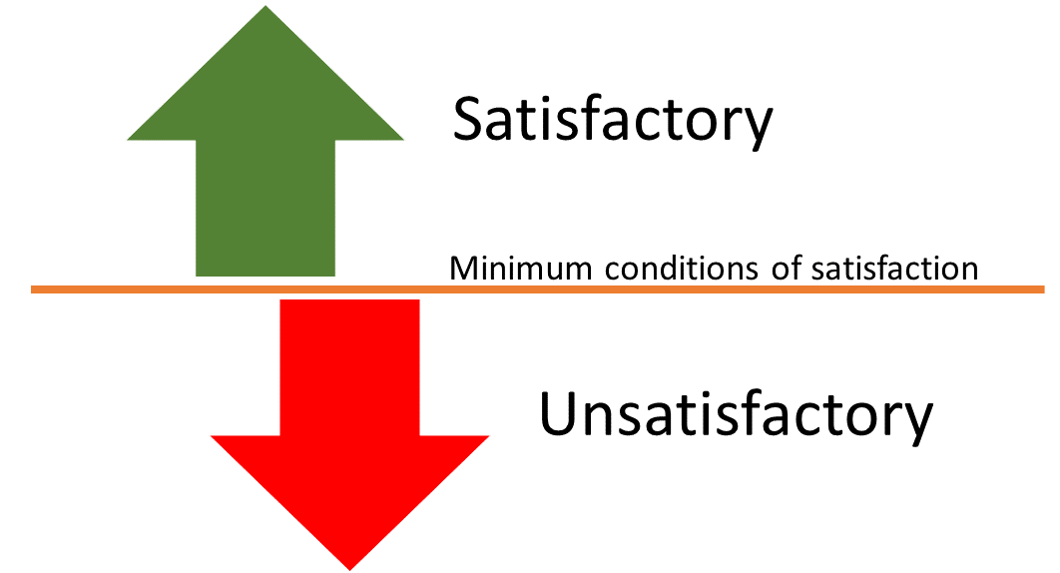
ERTA Pre-emption
Field Preemption → Minimum Harmonisation
    Opinion 2/91: ILO convention imposed minimum standards for workers’ protection in an area where directives also imposed minimum standards
    Mox Plant: external competence in the field of the protection of marine environment is «in principle shared between the Community and the Member States» (Art. 193 TFEU).

Slide 33

ERTA Pre-emption
Field Preemption: → Partial Harmonisation
    Opinion 1/94: Community legislature had achieved «only [a] partial harmonization» in the sectors falling within the scope of TRIPs
    Open skies: Community legislation on air transport was «not complete in character»

Slide 34

ERTA Pre-emption
Conflict Preemption → Rule Pre-emption
  E.g. Opinion 1/03
    Lugano Convention relies on «domicile of the defendant» criterion
    This could «conflict with the provisions» of Regulation 44/2001 that establish a different jurisdiction if the defendant is domiciled in a NMC but has establishment in a MS.

Slide 35

ERTA Pre-emption:
Conflict Preemption → Obstacle Pre-emption
    E.g. Green Network
      Under IT-CH agreement, energy imported from Swiss to Italy could be certified as green
      This «could interfere ... with the objectives of Directive 2001/77» i.e. to increase MS production of green energy.

Slide 36
IV. Constitutional pre-emption

Slide 37
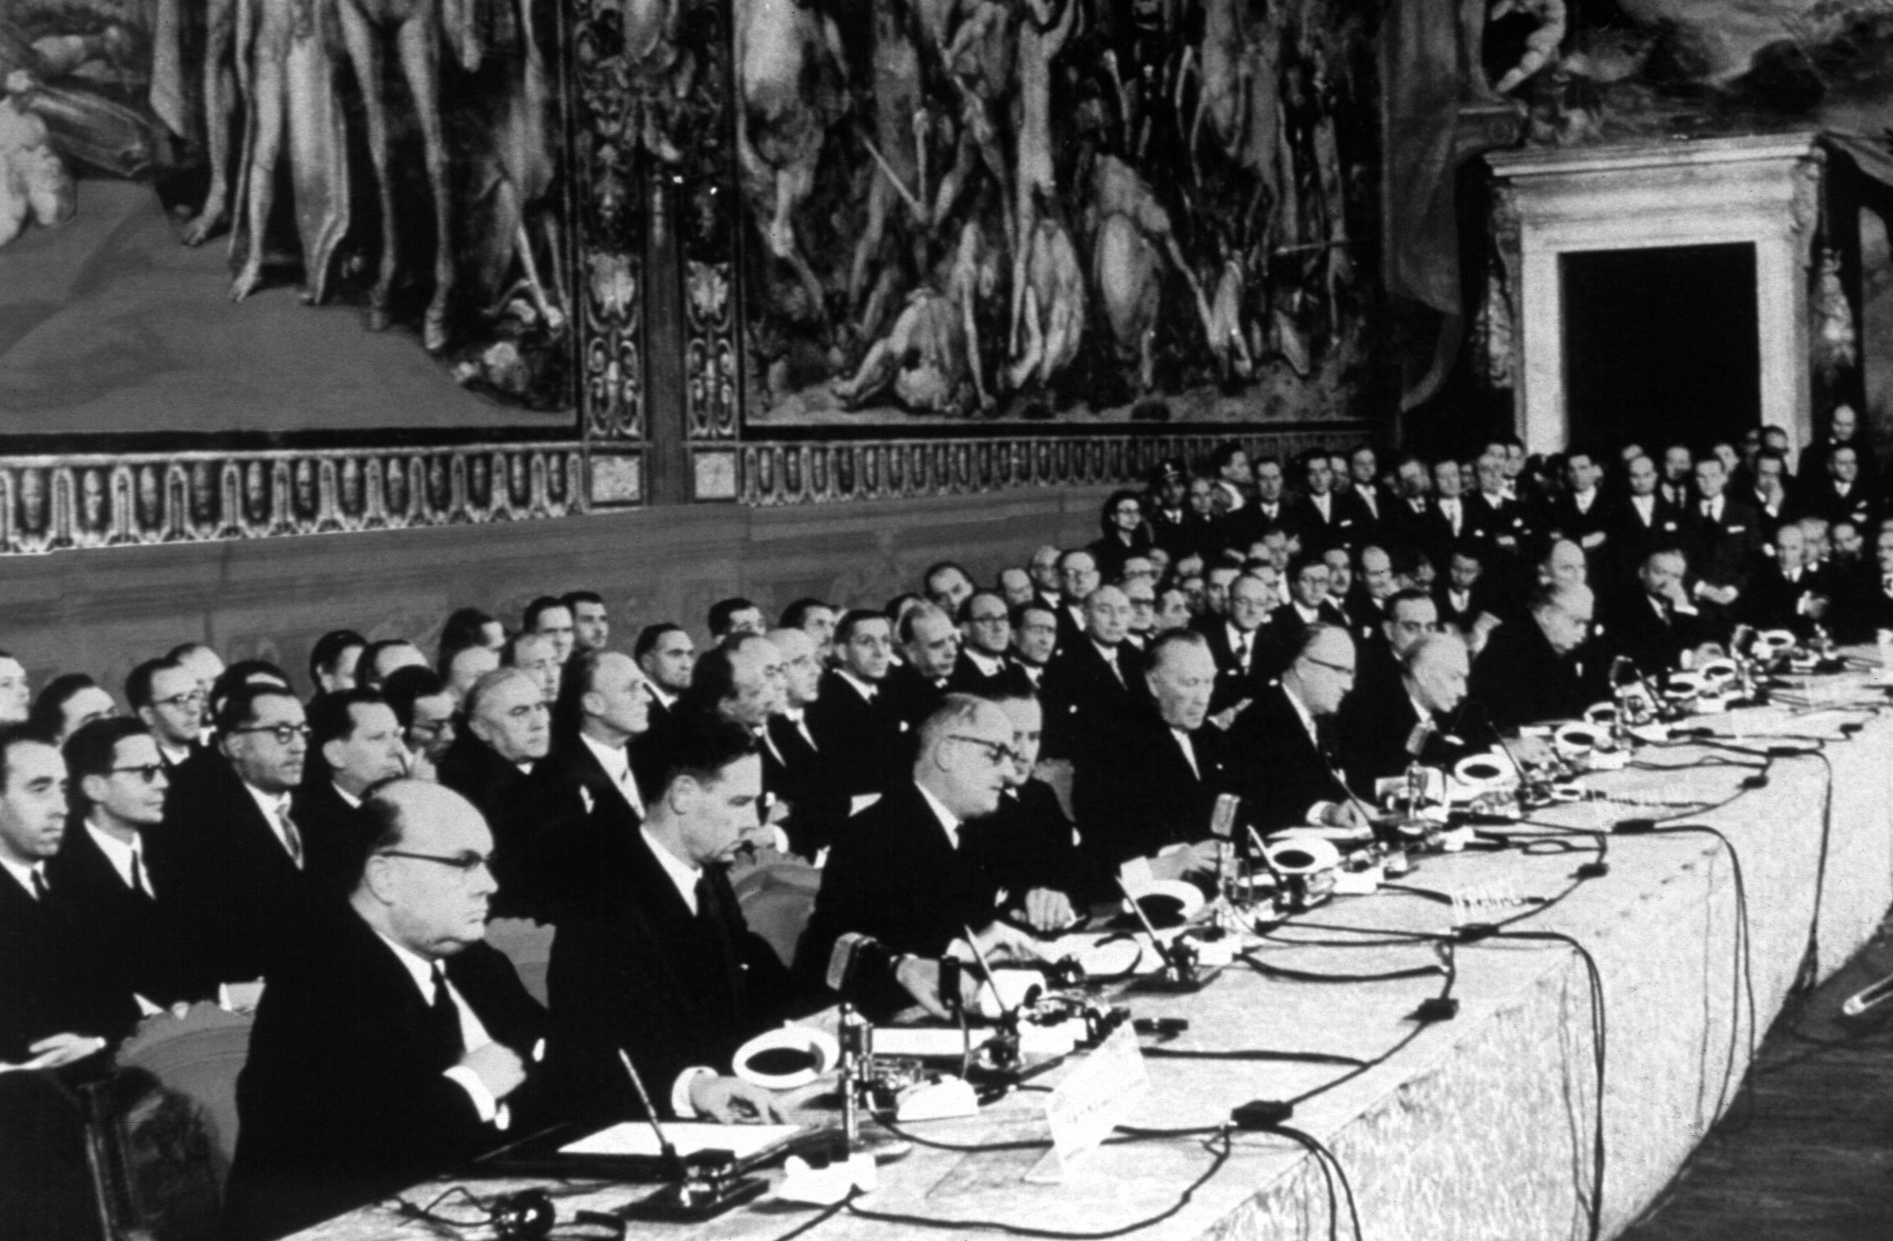
Constitutional Pre-emption: Overview
Scope overlap test
  + Positive
  Negative
Field pre-emption
  + Exclusive power
  – Delegation
  – Implementation
  Conflict pre-emption
    Rule pre-emption
    Obstacle pre-emption

Slide 38

Constitutional Pre-emption:
Scope overlap test
Broad provisions / no definitions
Unwillingness to rely on preparatory work
Derogations can be broad too (Com. v. Latvia – Notaries)
Do FR have an autonomous scope?
Various methodologies in defining, for instance, CCP:
  Evolutionary approach (Op. 1/78: liberalization & regulation of trade
  Systemic understanding (Op. 1/94: only mode 1 is CCP)
  Primary objective (Op. 3/15 Marrakesh Treaty)

Slide 39

Constitutional Pre-emption:
Field Pre-emption
Exclusive power
  Exhaustive list in Art. 3(1) TFEU (a priori exlcusivity)
  But also other provisions (e.g. Art. 344 TFEU juncto Art. 276 TFEU in Achmea)
  Non-retroactive & presupposes some EU exercise (e.g. Fisheries)
  ECJ prefers conflict pre-emption (e.g. AG2R: Art. 101&102 TFEU; Vebic: Reg. 1/03)
  CFR: Presumption against pre-emption in non-harmonised (MAS) or partially harmonised (Fransson) areas?

Slide 40

Constitutional Pre-emption:
Field Pre-emption
Delegation
  Requires a «specific authorization» (Donckerwolcke)
  E.g. stricter competition rules on unilateral conduct under Art. 3(2) of Reg 1/03
  It can be implied (Bulk Oil, Pansard)
Implementation
  In line with Art. 291(1), MS have a general implementation power
  Notion of implementation can be broad (like Fransson?)

Slide 41

Constitutional Pre-emption:
Conflict Pre-emption
Rule pre-emption
  Quite common, as primary law provisions have a broad scope (e.g. Dassonville, Kraus)
Obstacle pre-emption
  Often used to prevent circumvention (effet utile) (e.g. GB-Inno, Luisi & Carbone)

Slide 42
VI. CONCLUSIONS

Slide 43

Advantages of an EU Pre-emption Doctrine
Increased predictability of ECJ case-law
Increased transparency in the EU legislative process
Increased confidence in implementation of EU law
More constructive debate on MS regulatory autonomy

Slide 44

Suggestions for an EU Pre-emption Doctrine
Establish a presumption against pre-emption:
  For directives
  For certain competence types
Establish a clear statement (or form) requirement

Slide 45

If you liked the show, you’ll love the book:
A. Arena, A Doctrine of Pre-emption for the European Union: How EU Law constrains Member States’ Law-making and Treaty-making powers
(Forthcoming, OUP, 2021)

Slide 46

Thanks for your attention!
a.arena@unina.it

